Slide 1

Creating Budgets in
Business Central

Slide 2
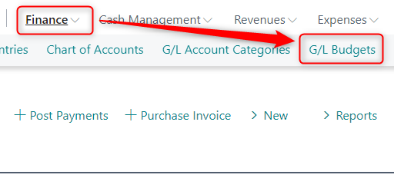
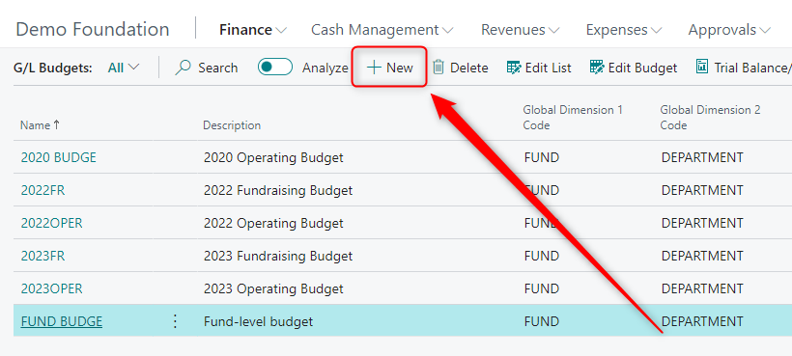
Creating a new budget
Finance>G/L Budgets
+New

Slide 3
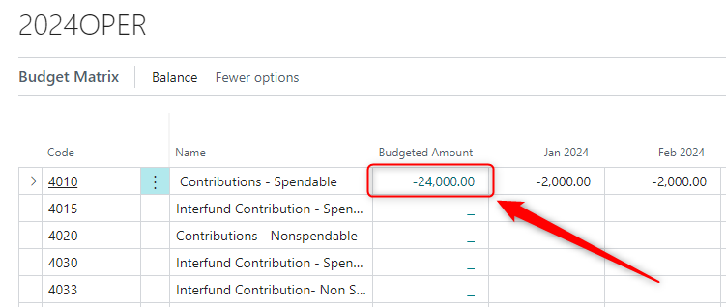
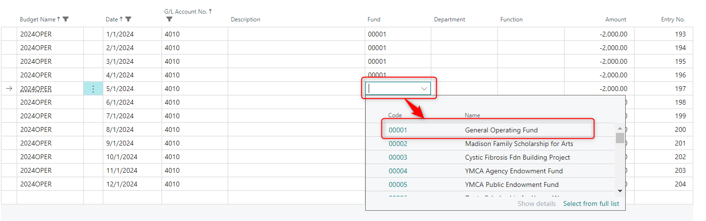
Adding Dimensions
Select Budget Amount
Enter Dimensions

Slide 4
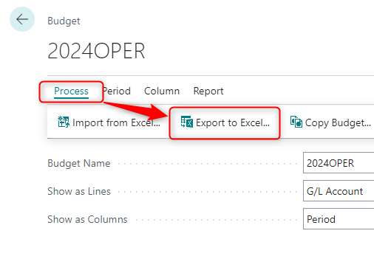
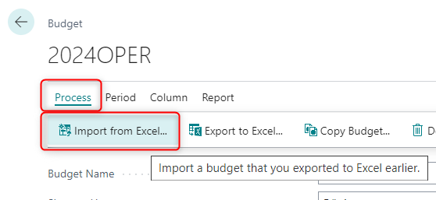
Exporting & Importing
Export to Excel
Import from Excel

Slide 5
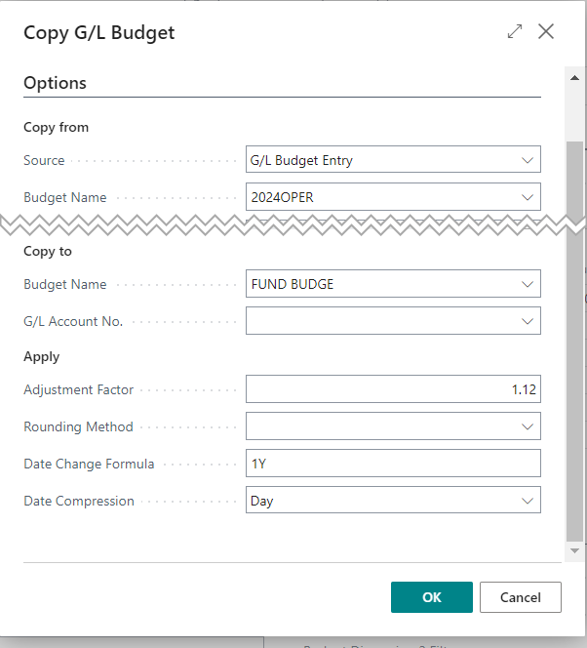
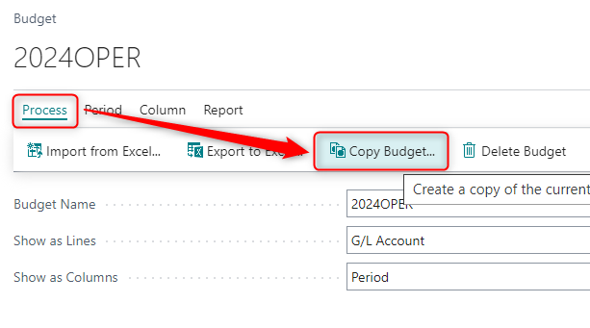
Copying Budgets
Copy Budget
Copy Options

Slide 6
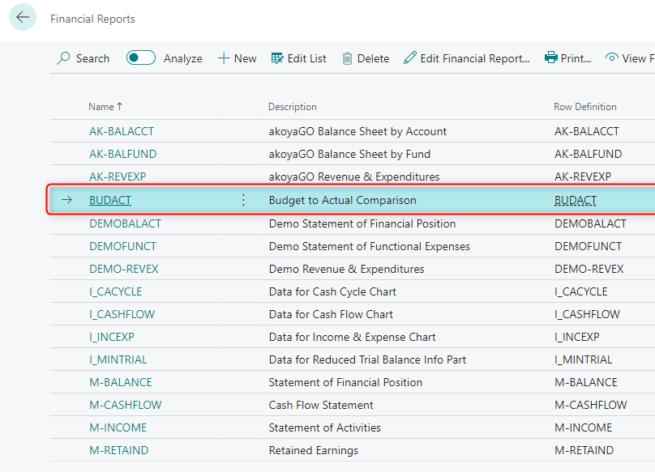
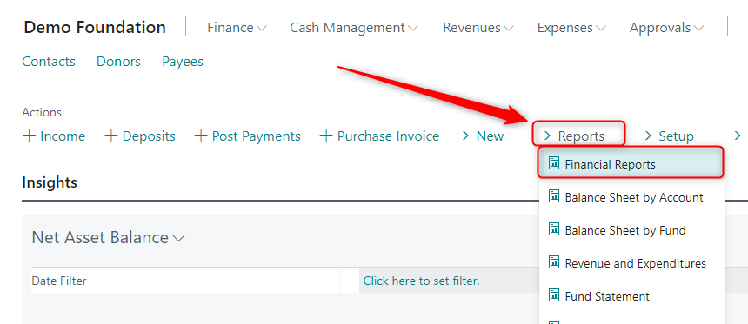
Standard Budget Reports
Open Financial Reports
Select Budget Report

Slide 7
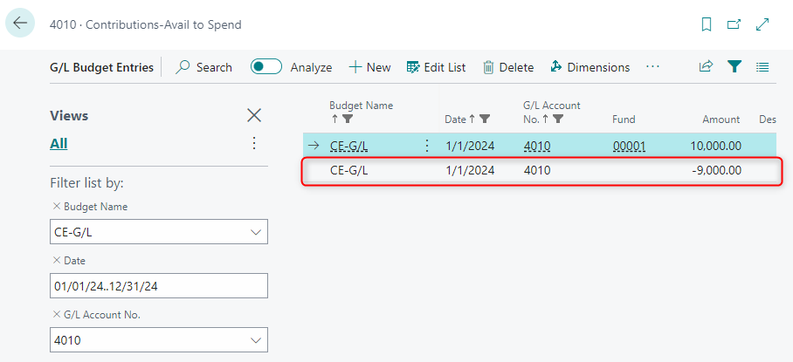
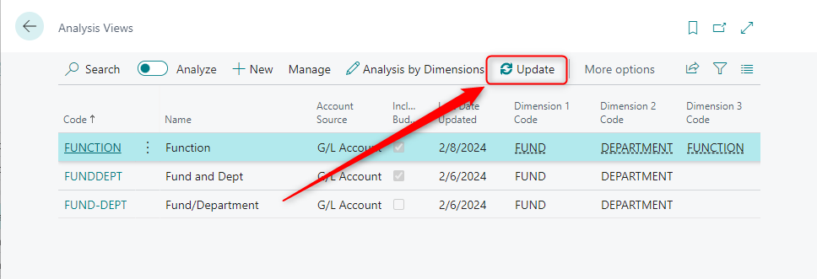
Troubleshooting
Budget Adjustments
Update Analysis View

Slide 8
More Resources
Creating G/L Budgets in Business Central - https://gosupport.powerappsportals.com/knowledgebase/article/KA-01419/en-us
Customizing Financial Reports - https://gosupport.powerappsportals.com/knowledgebase/article/KA-01074/en-us

Slide 9
Creating Budgets in
Business Central
Presented by Jeffery Tenbusch
support@akoyago.com

