Slide 1



Share your photos to
the conference album!
#EMPOWERED2024

Slide 3
akoyaGO CRM BASICS 101
PRESENTED BY
Eric Aquino | Philanthropic Consultant

Slide 4

Navigation
Data Entry
Activities
Additional Help & Resources
SESSION TOPICS
Notes:
We’ll bounce back and forth, talk through some slides and walkthrough the system
If you have questions, feel free to chime in

Slide 5
Workspaces
Navigation Bar
Entities
Dataverse & Quick Searches
Recent Menu
Pinning Records
Waffles
NAVIGATION

Slide 6
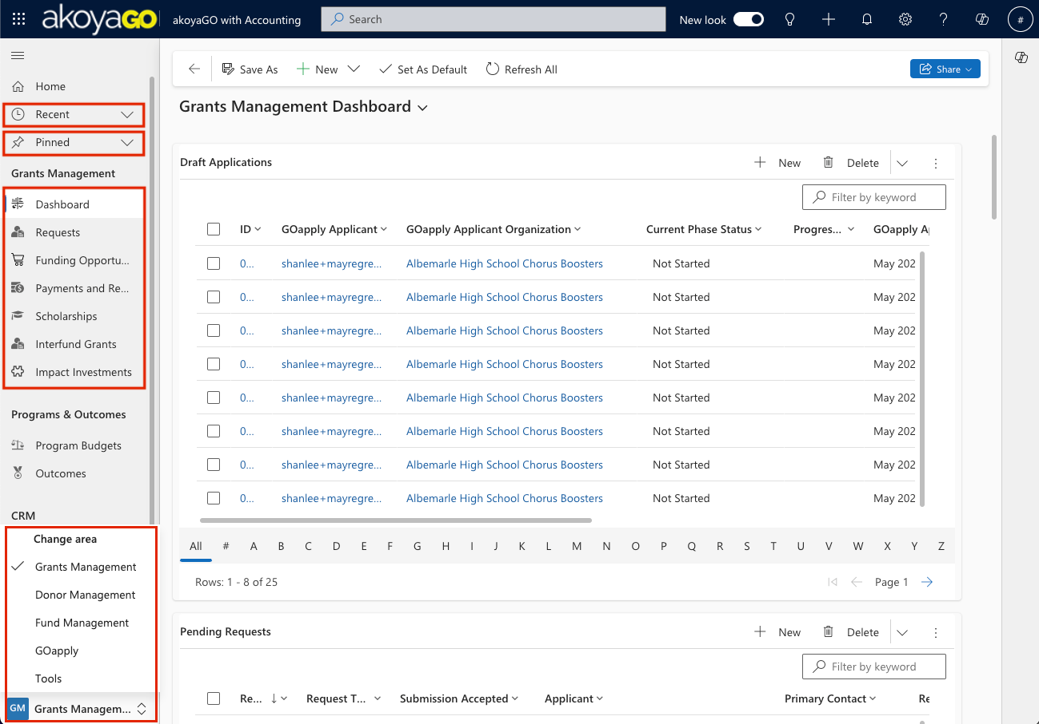
NAVIGATION
Notes:
Workspaces
Navigation Bar
Entities
Dataverse & Quick Searches
Recent Menu
Pinning Records
Waffles

Slide 7
Best Practices
Dataverse Search
Entering Requests
Approving Requests
Entering Gifts/Gift Payments
Sending Payments to Accounting
DATA ENTRY

Slide 8
DATA ENTRY BEST PRACTICES
Always start by checking if the record (Contact, Constituent, Donor) you are adding already exists in the system to avoid duplicates.
    Use the Dataverse Search to search across entities or the Quick Search to search a specific view within an entity.
    akoyaGO Best Practice is to begin with Dataverse Search, as this is a broader search and will return more results.
Notes:
Always check if the record exists

Slide 9
DATA ENTRY BEST PRACTICES
MANUALLY ENTERING A REQUEST
Enter Request from the Applicant's constituent record – Request tab. By starting here, you see historic Requests + Payments.
    Applicant, Payee, and Primary Contact will auto-populate. You can overwrite any of these fields from the Quick Create form if needed.
    If you enter an Original Grant Amount and Payment information on the Request Quick Create Form, you are entering an APPROVED REQUEST (and will also create a PAYMENT)
Notes:
Point out GOVerify to check Tax Status
Show how you can see history from the Requests tab

Slide 10
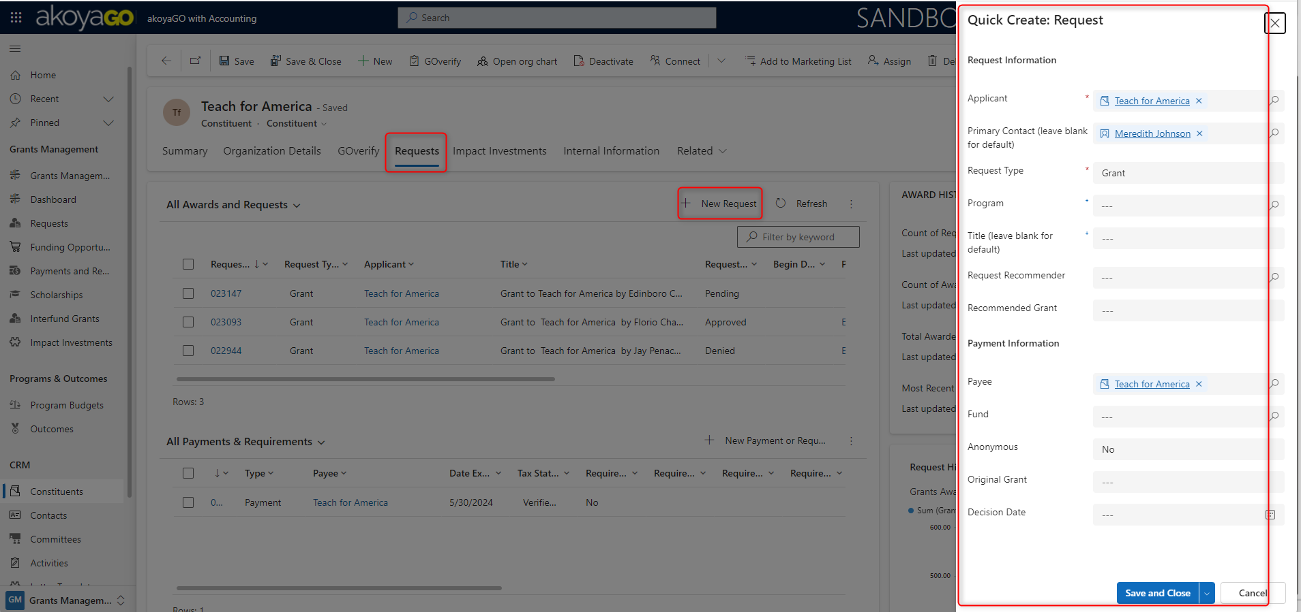
DATA ENTRY BEST PRACTICES
MANUALLY ENTERING A REQUEST

Slide 11
DATA ENTRY BEST PRACTICES
APPROVING A REQUEST
Best Practice is to approve the Request by using the "Approve" button at the top.
If approving for an amount other than the Recommended Amount (Donor Advised) or Requested Amount (Competitive Grant), you can enter the Original Grant Amount to Approve.

Slide 12
Data Entry Best Practices
Processing a Payment
When the Request is Approved, the Request Status will auto-updated and Payment will be automatically created.
Out of the box functionality is 1 payment will be created for the total Original Grant Amount.
    Edit/create additional payments if necessary (i.e. multi-year payouts)

Slide 13
DATA ENTRY BEST PRACTICES
PROCESSING A PAYMENT
If using akoyaGO with Accounting, make sure to thoroughly review payments before Sending them to Accounting. Once it exists in your GL, you have to post a correction.
You can use Request Payments to Send to Accounting System View to review a group of payments or can review individual records.
Best practice is to use the Send to Accounting button.
This view is also included in Payment Processing System Dashboard.
Notes:
We want to cut this if Product doesn't think it is needed for 101

Slide 14
DATA ENTRY BEST PRACTICES
ENTERING A GIFT
Enter the Gift and Gift Payment from the Donor Record.
By starting here, the Donor, Formal Acknowledgement, and Payor will populate. You can overwrite any of these fields if needed.
You will also see the most recent Gift information.
If using the Gift Quick Create Form, both a Gift and Gift Payment will be created.

Slide 15
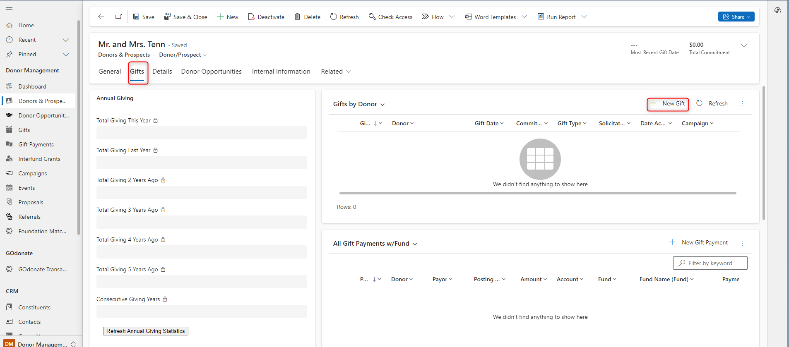
DATA ENTRY BEST PRACTICES
ENTERING A GIFT

Slide 16
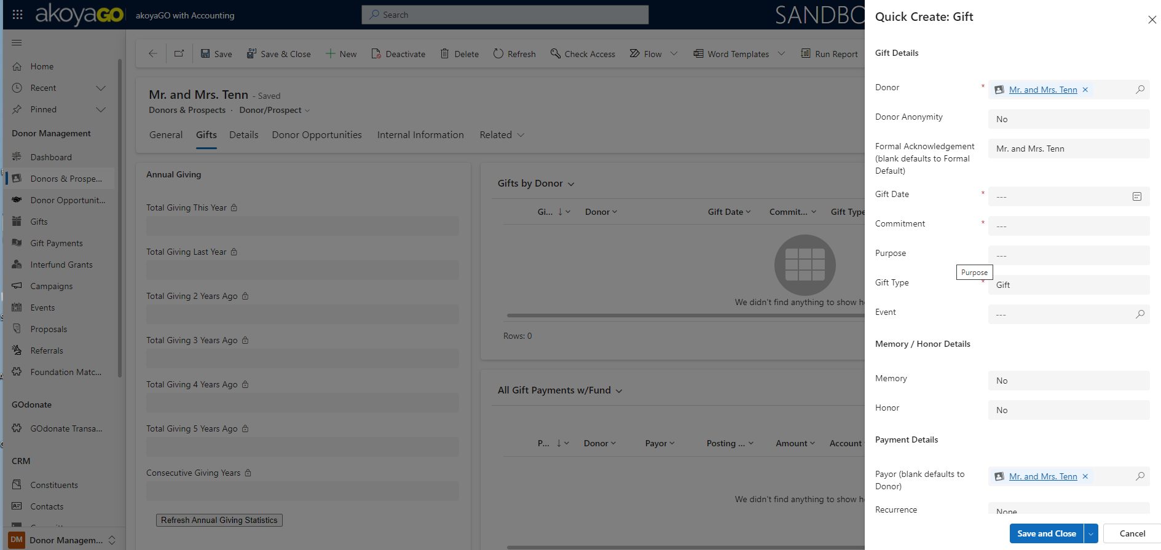
DATA ENTRY BEST PRACTICES
ENTERING A GIFT

Slide 17
DATA ENTRY BEST PRACTICES
PROCESSING A GIFT PAYMENT
If using akoyaGO with Accounting, make sure to thoroughly review Gift payments before Sending to Accounting. Once it exists in your GL, you have to post a correction.
You can use Gift Payments to Send to Accounting System View to review a group of Gift Payments or review the individual records.
Best practice is to use the Send to Accounting button.
This view is also included in the Payment Processing System Dashboard.
Notes:
-Want to cut this slide if Product thinks beyond 101

Slide 18
Types of Activities
Assigning Owners
Set Regarding
Timelines
Integrations/Automations
ACTIVITIES

Slide 19
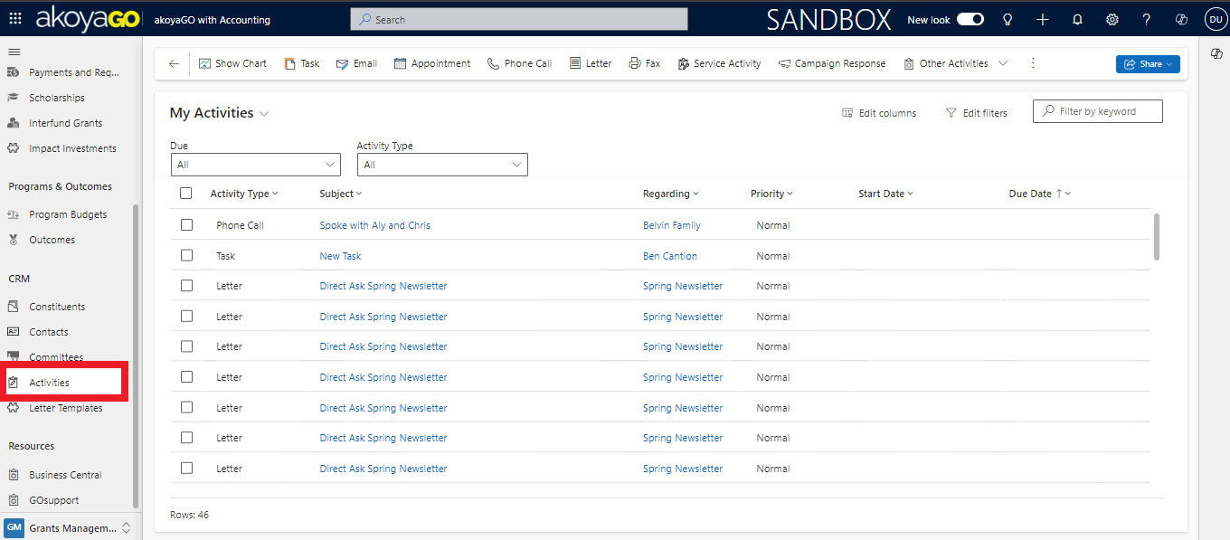
TYPES OF ACTIVITIES
Tasks
Appointments
Phone Calls
Emails
System Logs

Slide 20
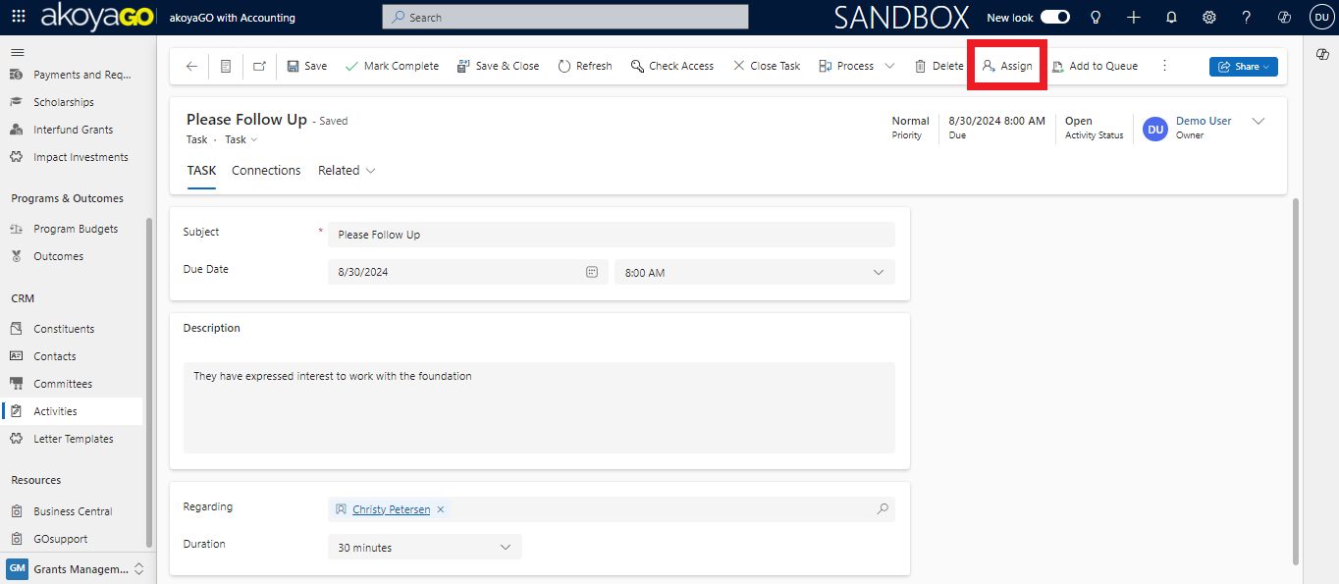
ASSIGNING OWNERS
You can assign any user to an activity. The best use case for assigning owners is Tasks.
    This allows the owner to maintain a personalized View of the tasks they own so they can better manage their work.

Slide 21
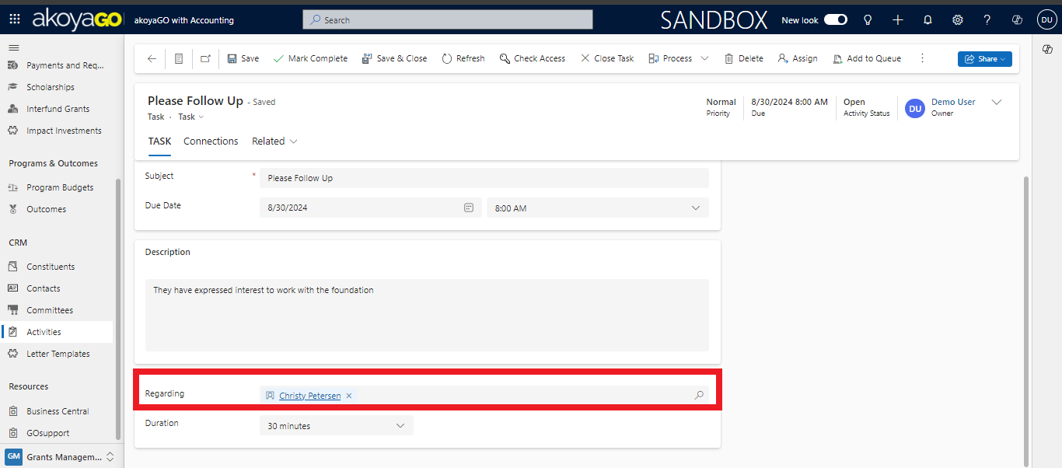
SET REGARDING
It is always important to set the Regarding field correctly. You can associate the activity with any record in the system.
    This will allow the activity to be logged onto the record’s timeline.

Slide 22
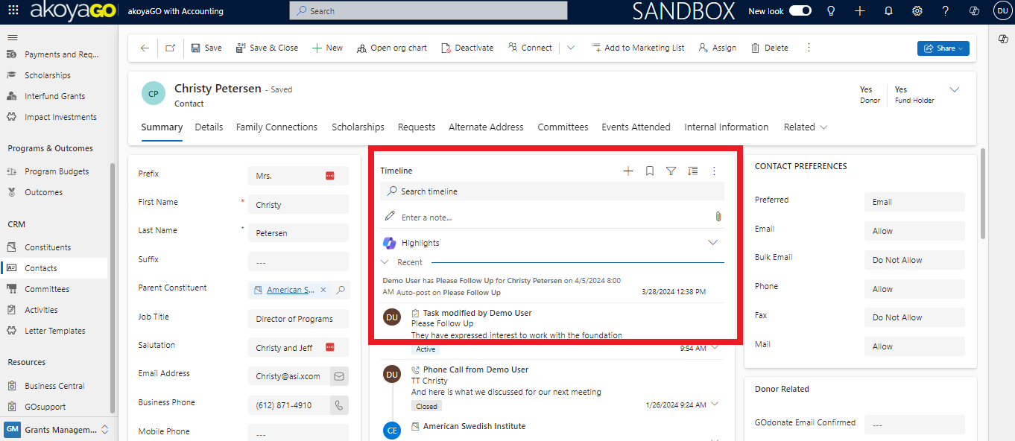
TIMELINES
Timelines exist on every record type in akoyaGO. They compile all Activities that are associated with that record.

Slide 23
INTEGRATIONS/AUTOMATIONS
Activities can be created automatically as logs to show Users when an automation has run, when an integration has been utilized, or when a portal function is enacted.
Examples include, but are not limited to:
  When a workflow/process is run on a batch of records
  An email is associated to a record via the Outlook integration
  A record is created via Goapply, Gofund, or GOdonate

Slide 24
GOsupport
Announcements
Knowledge Base
User Forums/Groups
Events
My Support
Creating Cases
Tracking and Modifying Cases
Feedback
HELP & RESOURCES
Notes:
Share your training material with your new staff members! Savannah

Slide 25
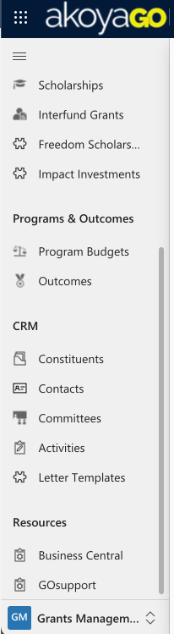
GOsupport
GOsupport is an application that allows clients to:
  Create Cases
  Onboard new users with training videos
  Increase knowledge through updated guides
  Interact with other clients through Forums
You can access GOsupport through the navigation Sidebar
or by visiting gosupport.powerappsportals.com
Notes:
GOsupport is an ever-evolving application that will continue to add new knowledge-based articles, as well as important archived white papers.
GOsupport’s main purpose will be the submission and tracking of Support cases. However, there will be other helpful areas to explore. It is recommended that once Users gain access to GOsupport, they familiarize themselves with all portions of the application.

Slide 26
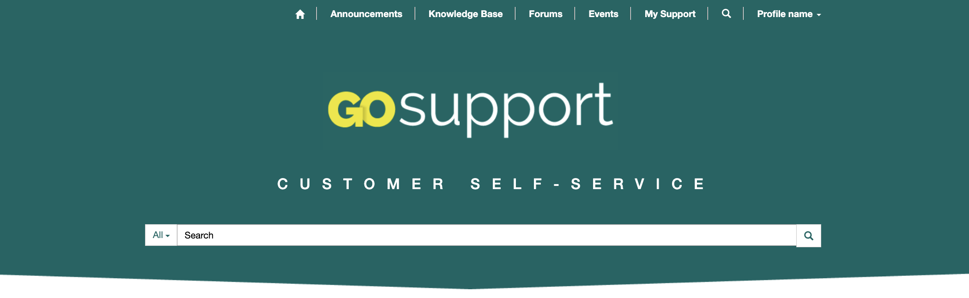
ANNOUNCEMENTS
Allows clients to be notified of major Product Bugs which have been identified by akoyaGO's Support and Development Teams.

Slide 27
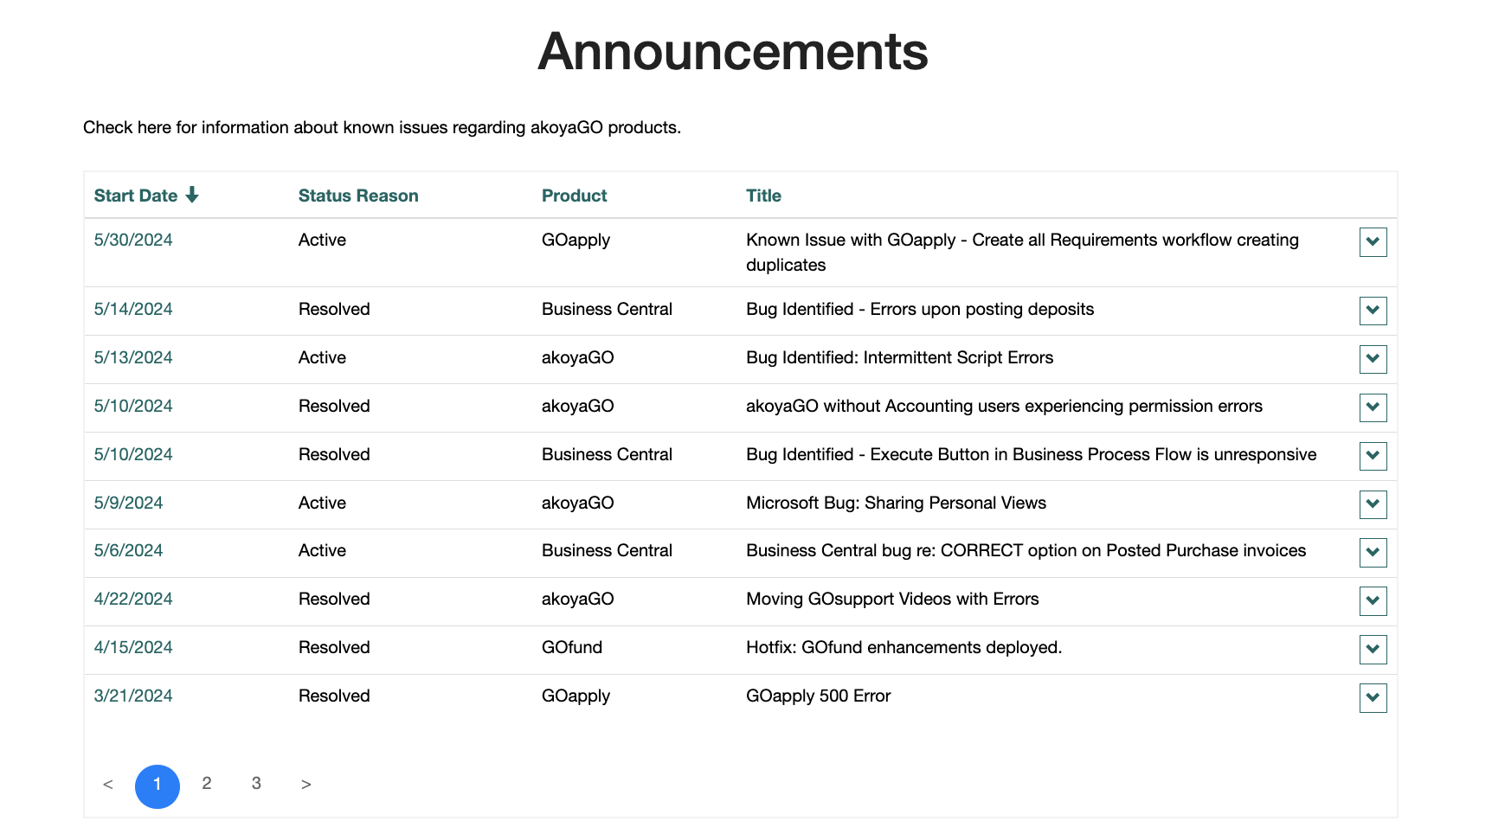
ANNOUNCEMENTS
Notes:
Within Announcements, it provides the Date, Status Reason, akoyaGO Product, and Title of the Case

Slide 28
KNOWLEDGE BASE
Provides clients with access to a collection of Knowledge-Based Articles, Videos, Webinars, and more.
Notes:
Within the Knowledge base, clients have access to a variety of resources which will allow self-sufficiency within the akoyaGO products.
When new users are added to your Organization, or accessing new areas of the products, we recommend that the Point of Contact or System Administrator creates a list of relevant videos and knowledge articles from the Knowledge Base specific to the new user's role within the organization.

Slide 29
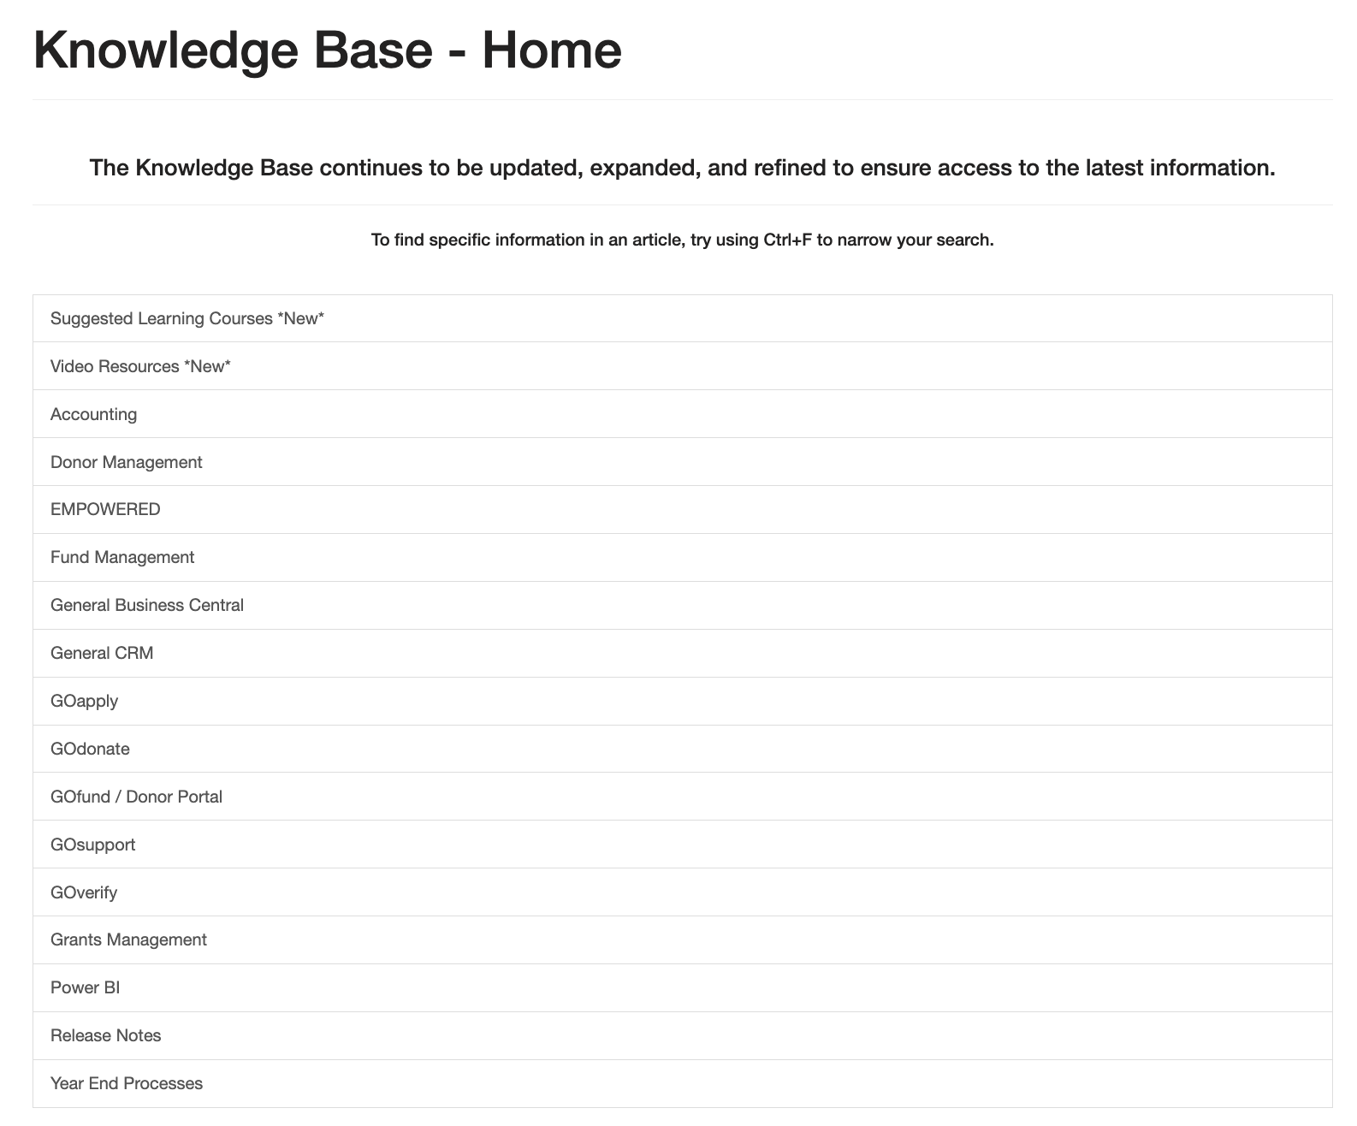
KNOWLEDGE BASE
Notes:
Many of our White Pages and videos are sorted by their associated akoyaGO Product or Category. Begin by clicking into a Category, and locating the relevant resource.

Slide 30
FORUMS
Forums are a place to connect and engage with other akoyaGO users to share Best Practices for managing data and additional insights on akoyaGO products.

Slide 31
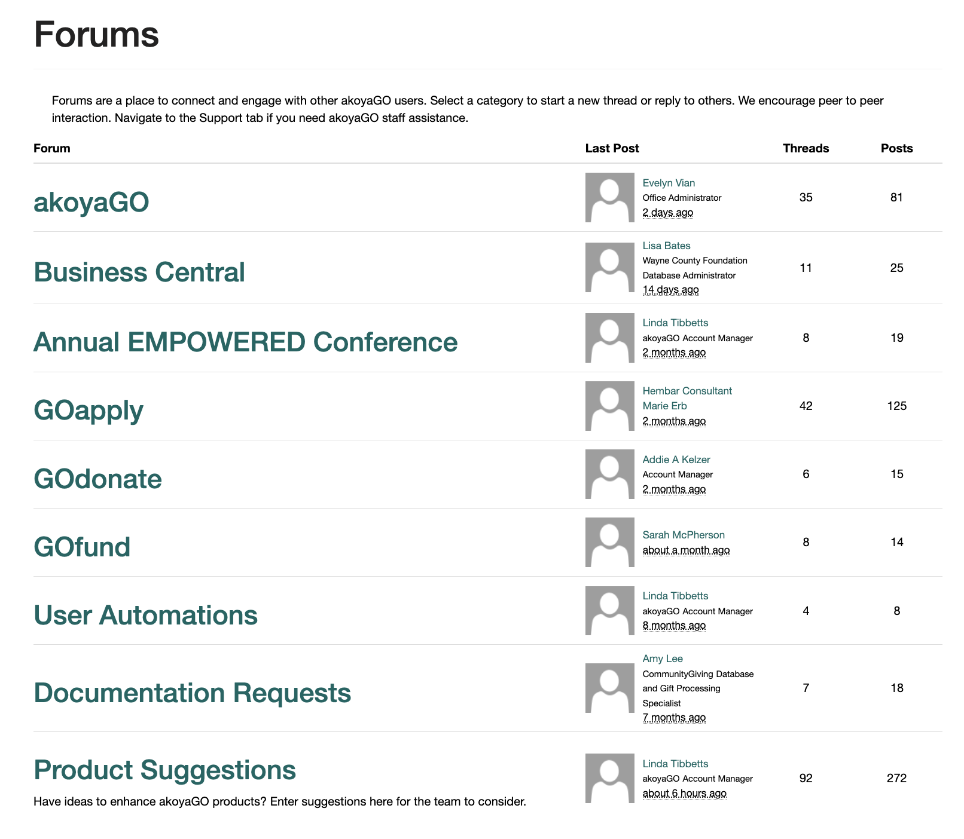
FORUMS
Notes:
Here, you can select a category to start a new thread or reply to others. We encourage peer to peer interaction.

Slide 32
EVENTS
Register for upcoming virtual events, such as User Groups and Product Update Webinars. Previous Event Recordings will become available within one day of the Event.

Slide 33
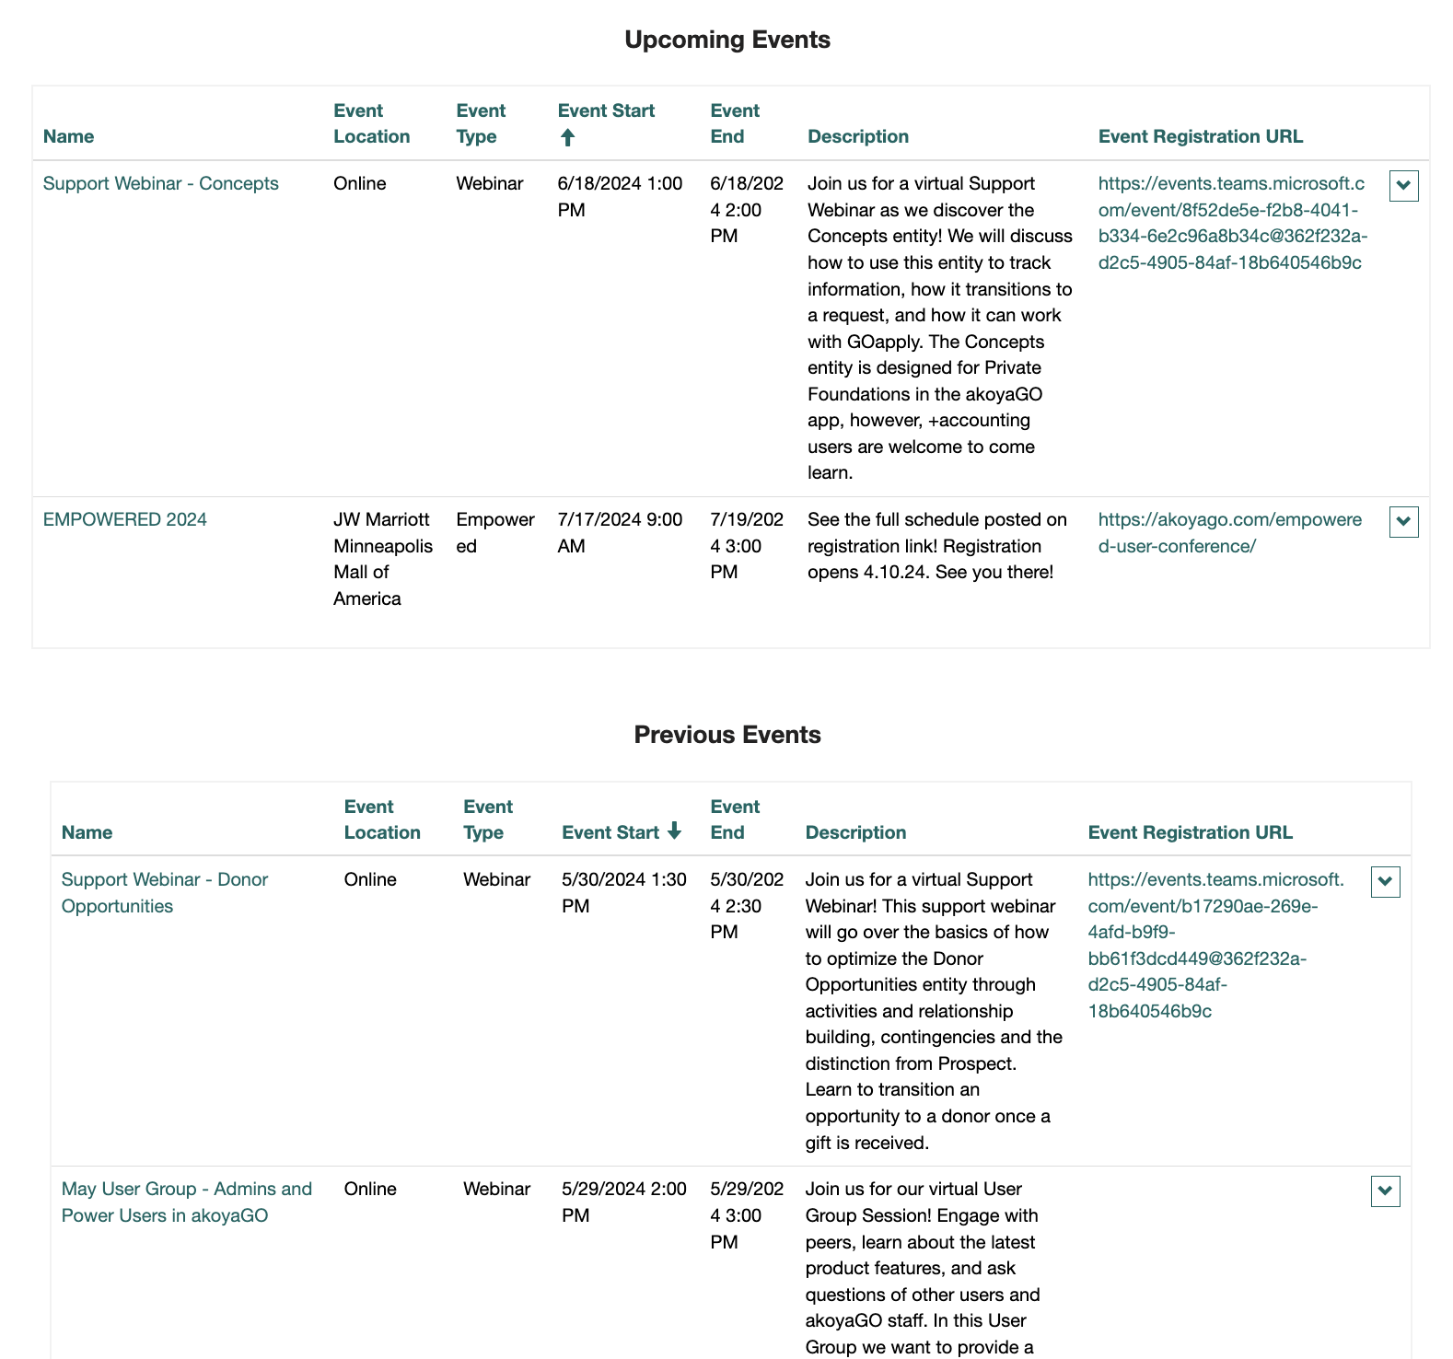
EVENTS
Notes:
To receive more information about upcoming or previous events, click the Name of the Event to access additional information including the Webinar's recording following the Event.

Slide 34
MY SUPPORT
My Support is where you can look for support resources, create cases, review the status of cases, add additional information/attachments, and cancel cases.
Notes:
Once in My Support, you are able to search for Guides related to your questions, open cases, and manage your active cases.

Slide 35
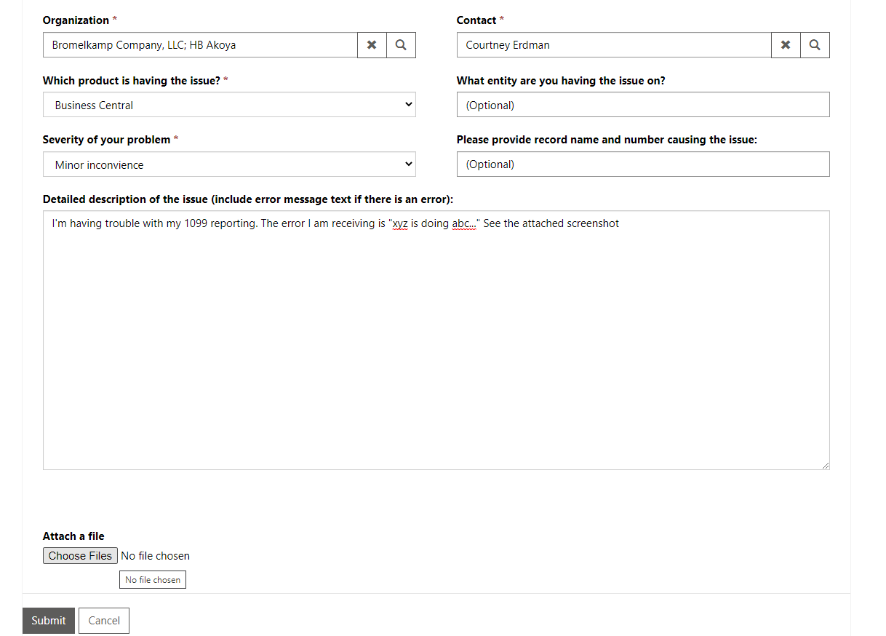
CREATING CASES
New Case Form
  Organization and Contact (autofill)
  Suggested Topics
  Products
  Entity & Record
  Severity of Case
  Attachments
Notes:
When you begin to type in the “Subject of Issue” field, you will notice a small refresh symbol appear. This refers to the fact that the system is searching for guides that may be helpful for you regarding this issue. After a moment, Suggested topics will populate related documents. If the suggested topics were not quite what you were looking for, or no options populated, you can choose to fill out all necessary information related to your concern:
The “Organization” and “Contact” fields will automatically populate (As long as you are logged in with your active work-associated email address)
There will be several distinct products to choose from (including an ‘Other’ option) from the drop-down for the required “Which product?” field
There are two optional fields:
“What entity” examples include: Contacts, Requests, Marketing Lists, Reports, etc.
“Record name and number” would likely relate to a specific gift/payment/contact/etc.
In the “Severity of your problem” drop-down, you can choose to give us an idea of how pressing the issue is, or if it is a question or request for customization
In the last text field, you will be asked to give as much detailed information as possible regarding your case.

Slide 36
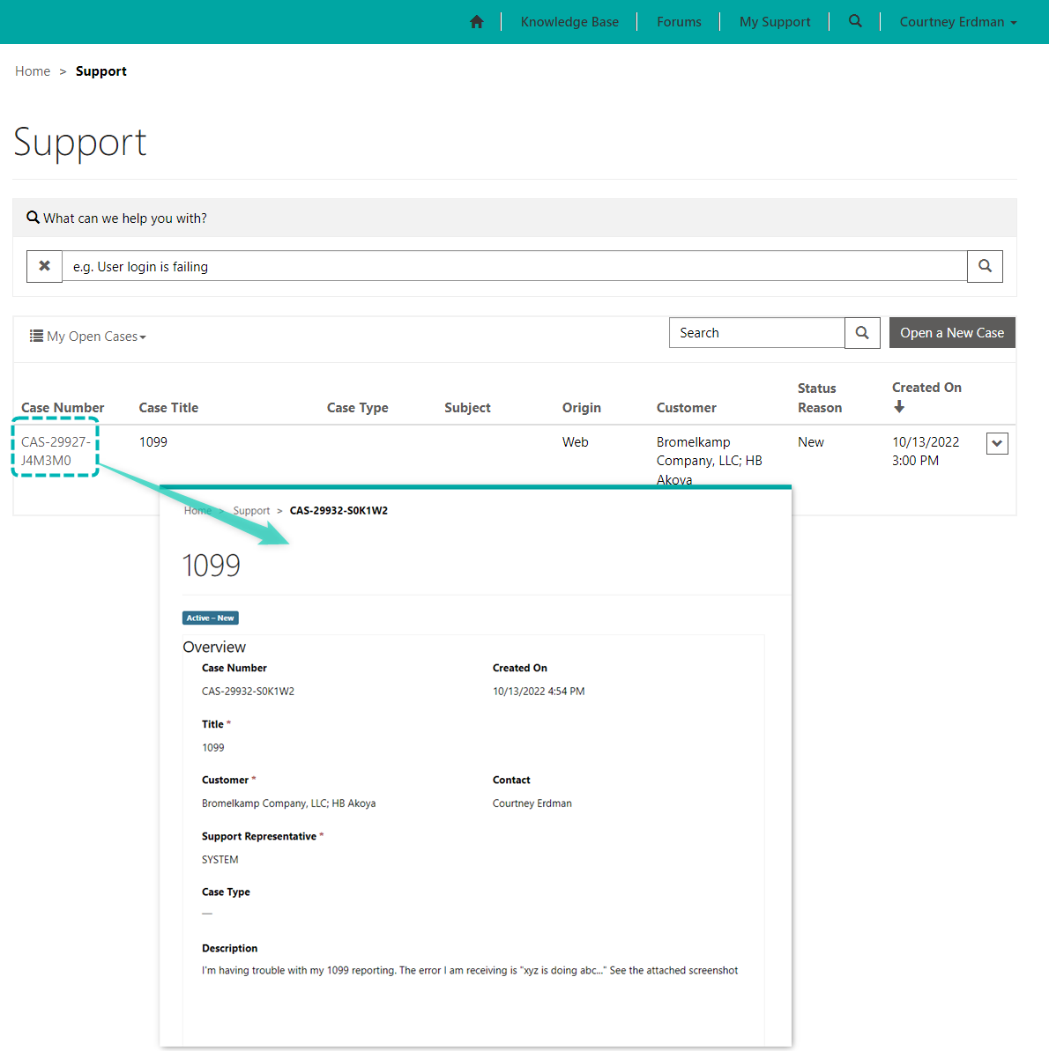
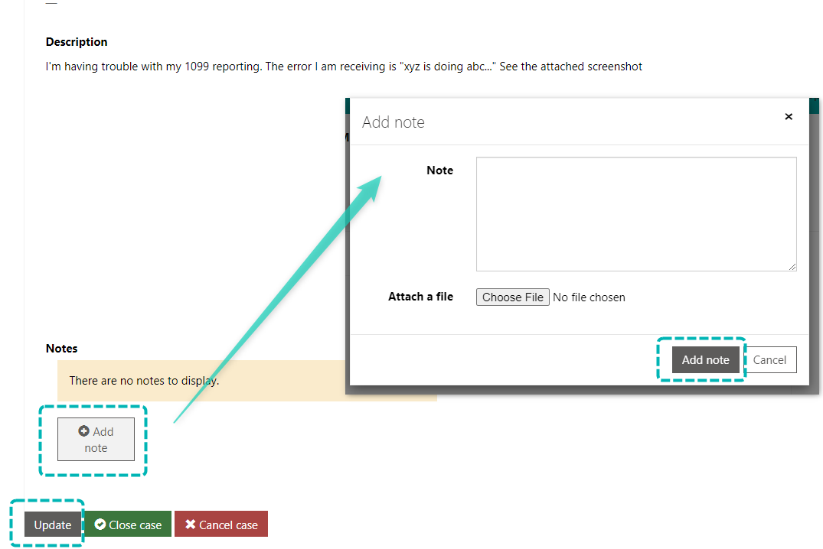
TRACKING AND MODIFYING CASES
Notes:
Clicking on the case number in My Support will take you into the case record itself. Once the Support Team have received a case, you will be able to track who has been assigned to it, the stage of the case, as well as any additional note attachments.
To add more information/ images, scroll to the bottom of the case record, and click the Add note button, then Update to finalize your note.
If a solution has been found regarding the subject of the case, you may choose to Cancel the case. If you believe the Support Team has successfully resolved your case (and they haven’t closed it on their side) you may choose to Close the case.
Both options are available to you at the bottom of each case record:

Slide 37
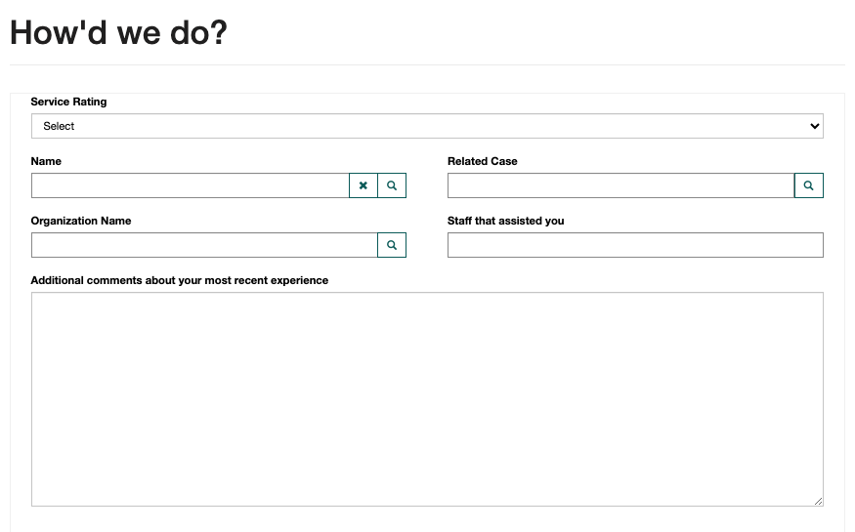
FEEDBACK
Notes:
We've recently implemented a new feedback system, accessible through the link "Tell Us How We're Doing" located in the signature of your Support staff.
Our aim is to gather insights, both positive and negative, from our valued clients. If you could spare a minute to share your thoughts upon closure of a case, we would be sincerely grateful!

Slide 38
RELATED KNOWLEDGE ARTICLES
CRM for Beginners ​
Major Components and Navigating akoyaGO
akoyaGO Basics - Suggested Learning Course​
Data Entry Basics (Video)​
Entering Constituents​
Entering Contacts​
Grant Request Quick Create ​
Gift Quick Create
Views, Search, Command Bar, and Forms​
Views and Dashboards Video​
Managing Views​
Utilizing GOsupport Portal​
Onboarding New User – Checklist​

Slide 39
PRESENTED BY
Eric Aquino
Philanthropic Consultant
SUPPORTING PRESENTERS
Savannah Eddie
Jen Tenn
THANK YOU

