Slide 1



Share your photos to
the conference album!
#EMPOWERED2024

Slide 78
CRM FOR ADMINISTRATORS
AND CUSTOMIZERS 301
PRESENTED BY
Marni DuVal | Agile Coach

Slide 79

CREATING
A CUSTOM SOLUTION
Create a custom solution in your environment to store all your customizations to any processes, cloud flows, tables, etc.

Slide 80
KEY FEATURES AND BENEFITS: CREATING A CUSTOM SOLUTION
Feature
Example
Benefit
  Creating your foundation’s custom solution to hold your configurations
  (Your Foundation’s Name) Configurations
Make them easier to access when edits need to be made.
It could also help reduce response time on Support or Tech Services cases, as it reduces confusion or the likelihood of conflicting updates.
Certain features such as triggering a PowerAutomate flow from a Business Process Flow can only be done when they are in solutions and will not be when they are added to the “Default Solution.”
Duplicate Detection Rules

Slide 81
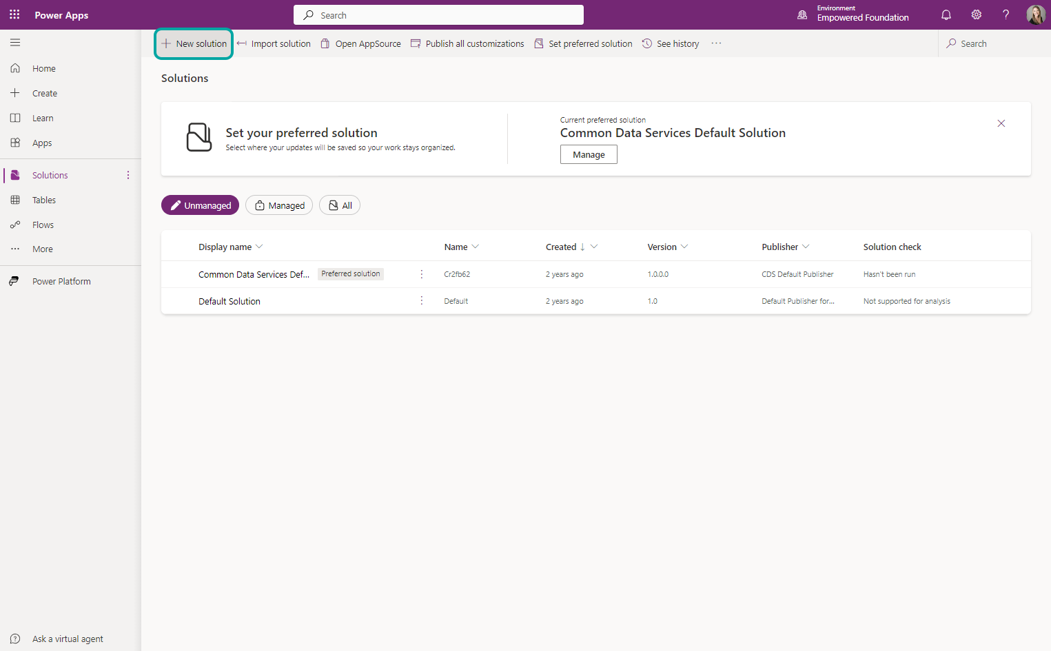
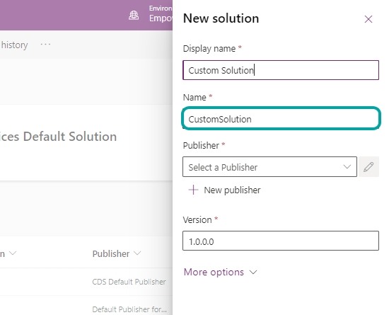
INITIAL STEPS
Open PowerApps and confirm the correct environment (Non-Default)
Click Solutions (Left Panel)
Click new solution
Give the solution a name

Slide 82
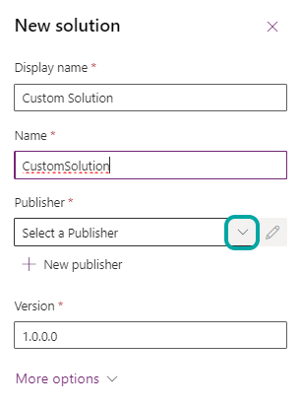
CREATE CUSTOM SOLUTION − STEPS
Click the publisher dropdown and choose the Default
Click the More Options towards the bottom
Type in a description
Click Create

Slide 83
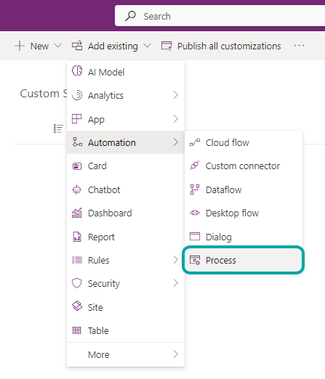
ADD COMPONENTS TO
NEWLY CREATED SOLUTION
You can add existing components from your default solution (such as processes, cloud flows, tables, etc.) To do this, click the "Add existing" button.
You'll see a list of all things that are available for you add.

Slide 84
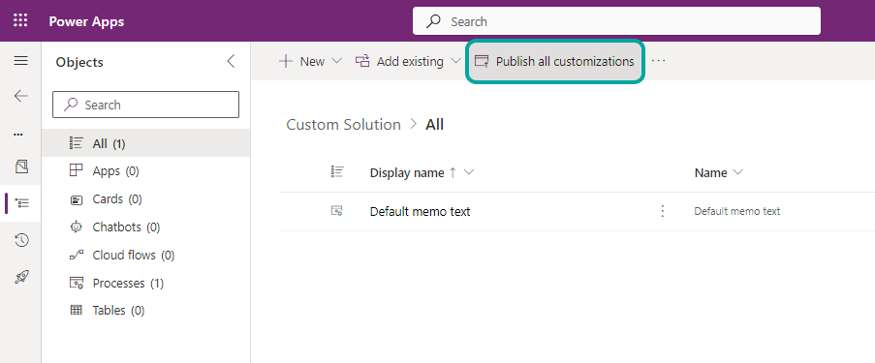
PUBLISH ONCE ALL CUSTOMIZATIONS ARE ADDED
Once you have added everything you want to your new custom solution, click on "Publish all customizations"

Slide 85
CREATING DUPLICATE DETECTION RULES IN MICROSOFT DYNAMICS 365
To ensure data integrity, it’s advisable to establish rules that minimize duplicate records within the system.

Slide 86
KEY FEATURES AND BENEFITS: DUPLICATE DETECTION RULES
Feature
Example
Benefit
  Duplicate Detection Rules
  A pop-up on the creation of a donor notifying you there is already a record in the akoyaGO that matches the information you input.
  Gives you the ability to flag duplicate records based on criteria you set (ex: “email address” field) to ensure data integrity and avoid having to “merge” records or manually “clean up” in the future.
Duplicate Detection Rules

Slide 87
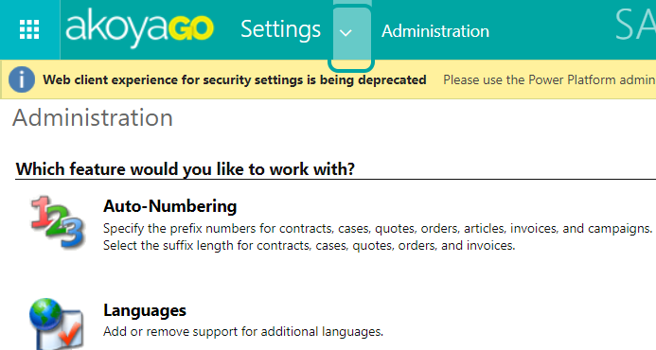
INITIAL STEPS
Navigate through the top right gear icon to ’Advanced Settings’
Click the Settings drop-down
Click Data Management
Then Duplicate Detection Rules

Slide 88
CREATING A NEW RULE
Click on new in the top left
Type in a rule name and select the entity that pertains to your rule
Select the fields and parameters you want to apply
Click Save and Close

Slide 89
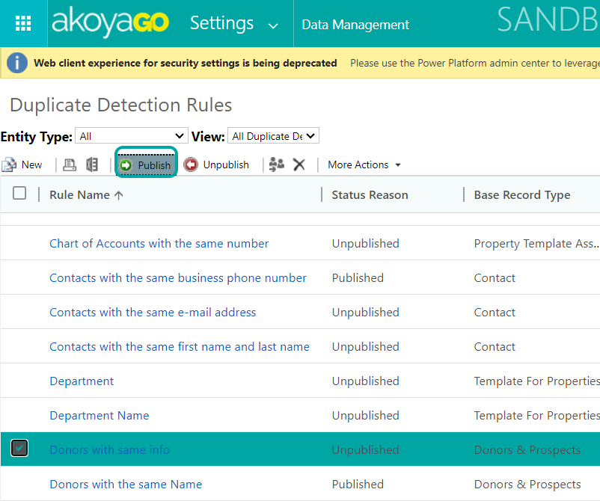
PUBLISH NEW RULE
Select the new rule from the view
Click publish then OK

Slide 90
While Power BI creates some slick-looking visuals, Dynamics 365 Charts gets you closer to the structures holding your data so that you can work with visual representations of your data on the fly.
BUILD A CUSTOM CHART IN POWERAPPS

Slide 91
KEY FEATURES AND BENEFITS: CREATING CHARTS TO VISUALIZE DATA
Feature
Example
Benefit
    Creating your charts to visualize your data
    A visual solution for seeing Donor Opportunities by Status and Inclination
    Data visualization tools can be a resource for training staff, finding gaps in data integrity (Yay! Cleaning projects ☺), and anticipating your process opportunities/
    efficiencies.
Duplicate Detection Rules
Notes:
- Great resource for training staff

Slide 92
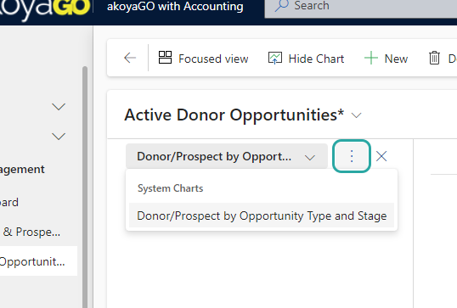
INITIAL STEPS
From any view click “Show Chart”
Click The 3 Dots
Click New

Slide 93
NEW CHART STEPS
Choose your chart style
Select the different entities for each axis of the chart
Click save
Return to CRM to view the new chart

Slide 94
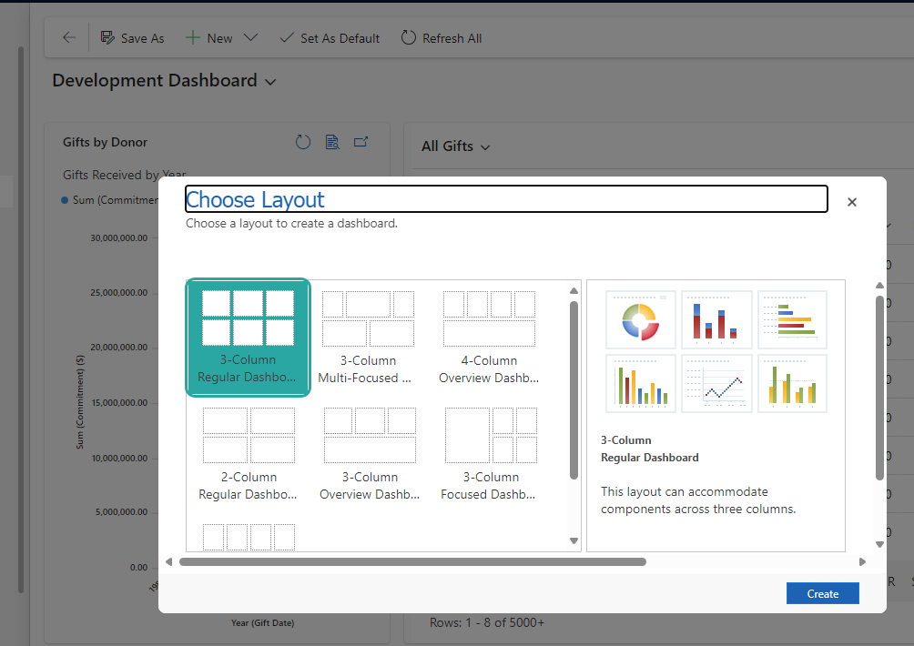
APPLY CHART TO A DASHBOARD
Click dashboards on the left panel
Click new in the header
Choose a layout
Then click ‘Create’

Slide 95
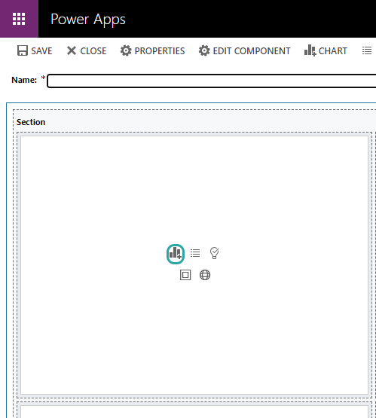
DASHBOARD (CONT.)
Click the chart Icon
Select your Record type and view/chart
Click Add
Give your dashboard a name and click save

Slide 96
Resources
How to Build Custom Charts in PowerApps
Creating a Custom Solution with PowerApps
Duplicate Detection Rules and Merging Duplicates

Slide 97
Presented By
Marni DuVal
Agile Coach
Supporting Presenters
Zoey Fife, Boone Kizer, Parker Robinson
THANK YOU

