Slide 1

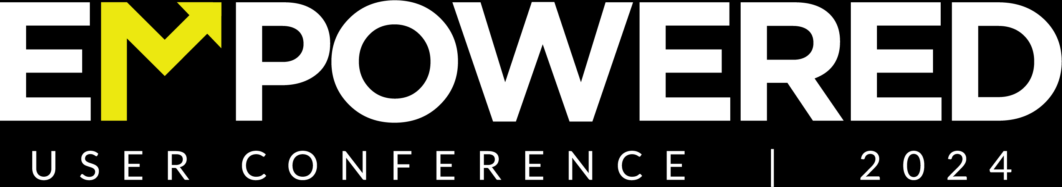

Share your photos to
the conference album!
#EMPOWERED2024

Slide 3
GOdonate FEATURES AND FUNCTIONS
PRESENTED BY
Alyson Belvin | Director of Client Services

Slide 4

GOdonate
Setup/ Implementation
Donor Experience
Processing GOdonate Transactions
Out of the box tools
OBJECTIVES

Slide 5
WHY GOdonate?
akoyaGO Intention
Reduce data entry
Donor Self Service
Expand your reach
Ability to spotlight funds
All in one solution
    Donor & Fundholder Stewardship
ICF
Integration - want to be all in on akoyaGO Products
Ongoing improvements and innovation

Slide 6
IMPLEMENTING GOdonate
Prepare
Review Fund Details
Determine public fund information
Setup
Complete GOdonate Settings and configure flows
Design the site
Test
Test making and receiving donations
Edit and test email templates
Launch
Add GOdonate link to a website
Share news with donors

Slide 7
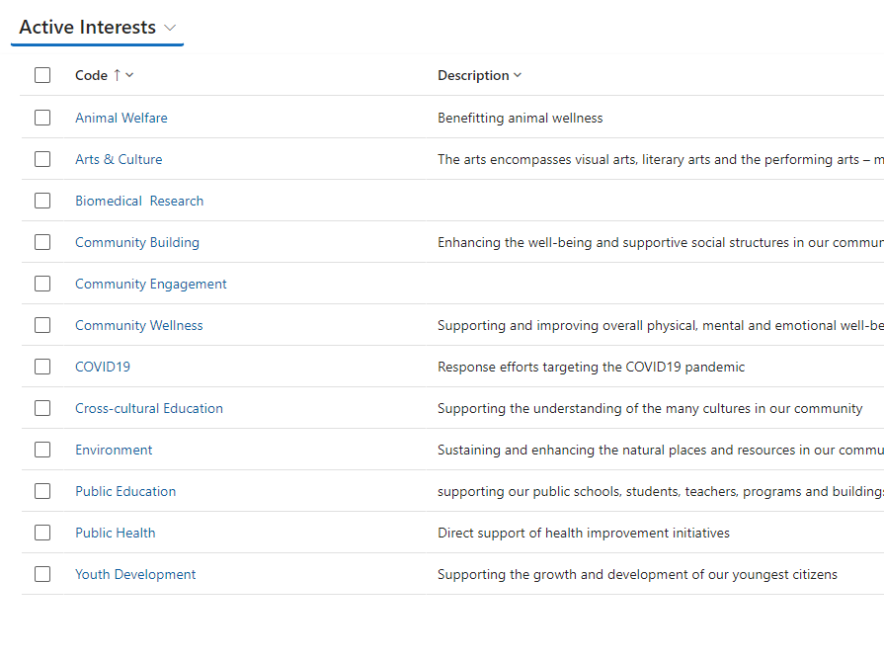
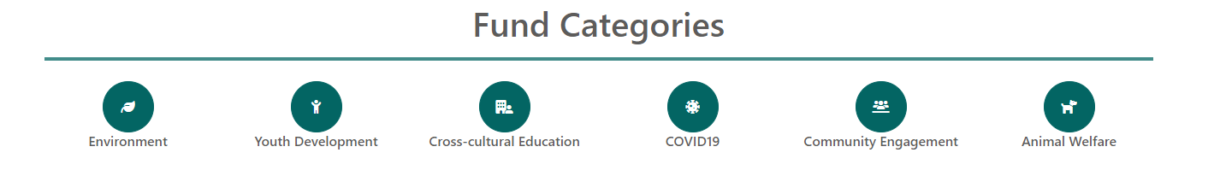
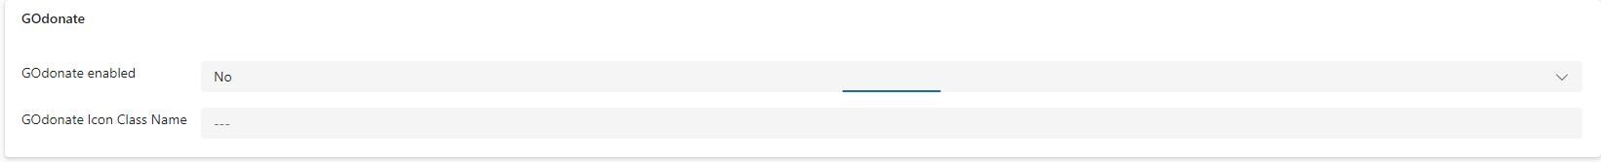
INTERESTS

Slide 8
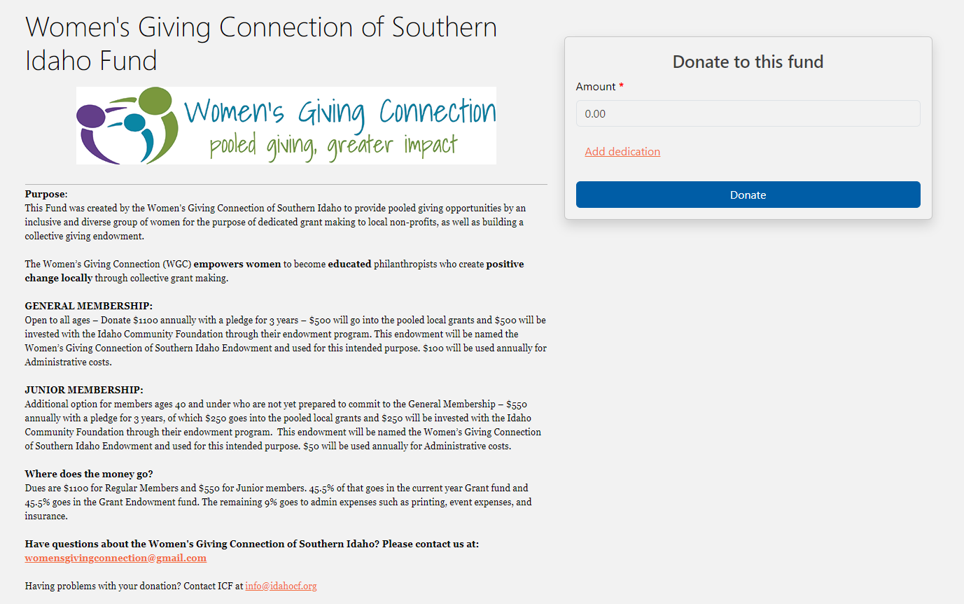
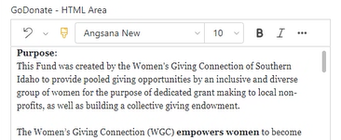
IDAHO COMMUNITY FOUNDATION
GOdonate Settings
Customization for Rich Text Field on Fund Detail
Theming
Notes:
Highlight of the rich text editors and customize to match websites
Keep ICF site pulled up to show the translation between CRM and GOdonate
Gauge the crowd for interest on the GOdonate HTML field on Fund Detail

Slide 9
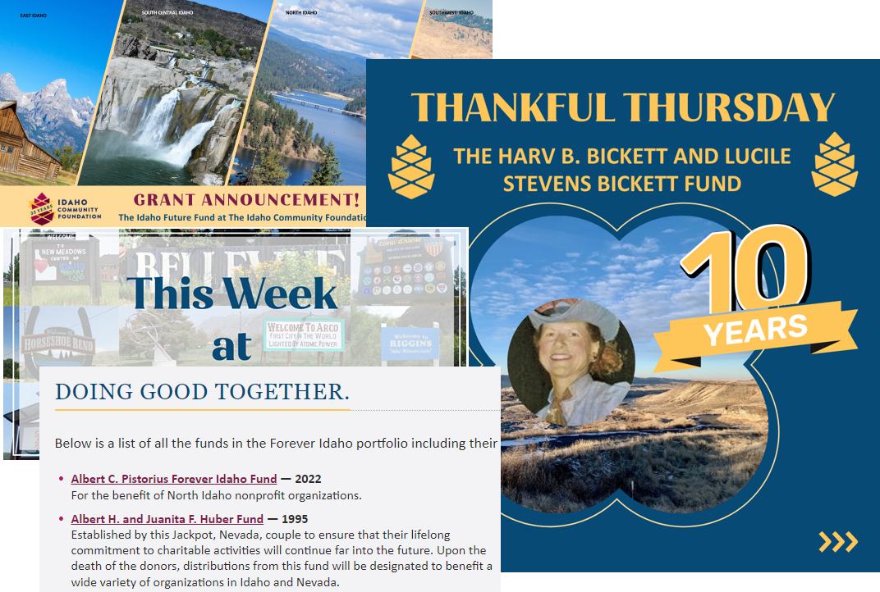
IDAHO COMMUNITY FOUNDATION
Communications that link to GOdonate page
Website
Newsletters
Special Announcements
Social media

Slide 10
DONOR EXPERIENCE
Click Donate from Website
Browse/ select funds in GOdonate
Make a donation
Create a donor account (optional)
Receive a donation confirmation email!

Slide 11
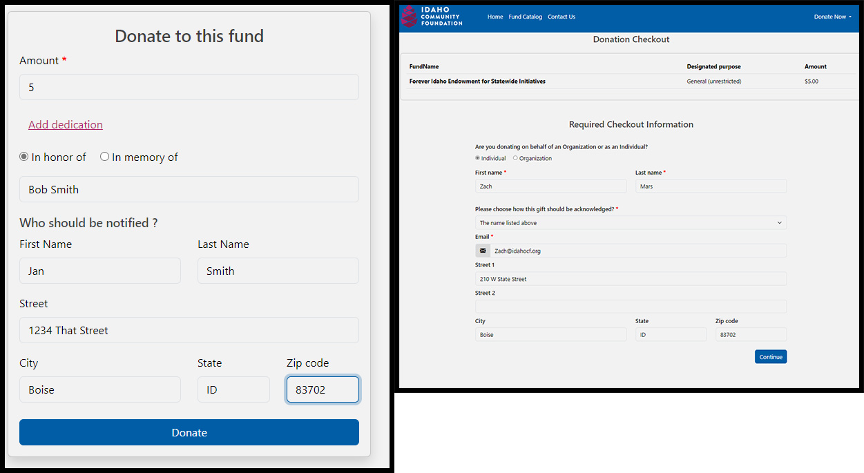
IDAHO COMMUNITY FOUNDATION
Giving a donation
Bypass login / Tracking user activity
Notes:
Zach will walk through the donation steps in ICF GOdonate
We are planning to allow more required fields options in a future release (reason why not in MVP, wanted to eliminate barriers for donations at the start)

Slide 12
Review GOdonate Transactions View
Assign donor to transaction (if needed)
If New Donor, run GOdonate Transaction New donor Creation flow
Once donor is assigned & payment status is complete, the CRM will create a gift record
Process gifts as usual
PROCESSING TRANSACTIONS IN CRM

Slide 13
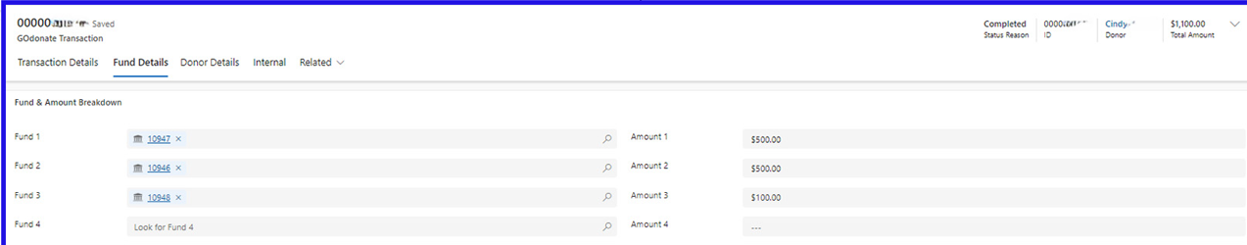
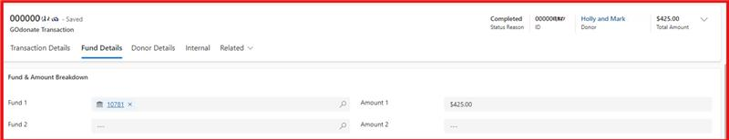
IDAHO COMMUNITY FOUNDATION
Gift Processing Frequency
Multi Fund and Single Fund Gift Processing
Notes:
ICF does a lot of multi-fund gift processing, communicated to donors of how to break out donations
Process gifts 2-3 times a week, staff will do that based on views to check most recent transactions
Clicking a live demo: View >> transaction entity >> Assign donor

Slide 14
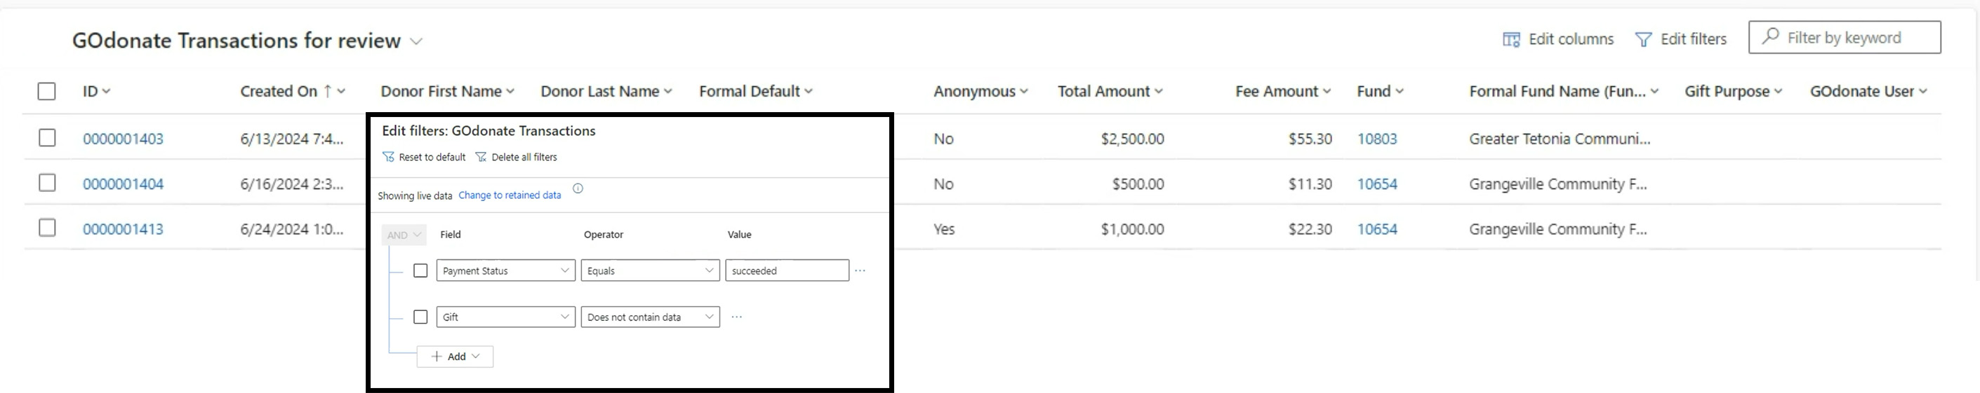
IDAHO COMMUNITY FOUNDATION
Views and Dashboards for Processing GOdonate Transactions
Donor Communications
Notes:
Send paper to donors that ask for it
Emails go out to donors as well
Flow built by TS – Letters are generated based on fund, gift type, etc.
Letters entity coming soon to manage these types of communications

Slide 15
OUT-OF-THE-BOX TOOLS
EMAIL TEMPLATES (All sent via CRM code, activity tracks to fund timeline)
    GOdonate Donation Confirmation Email – Sent automatically on submission
    GOdonate Email Verification
    GOdonate On-screen Payment Confirmation
    GOdonate Reset Password
Notes:
Donation confirmation email is coded –

Slide 16
OUT-OF-THE-BOX TOOLS
VIEWS
    Active GOdonate Transactions
    GOdonate Transactions for Review
    GOdonate Fund Card (Funds Entity, public-facing data on fund detail pages in GOdonate)
    GOdonate Enabled Funds (Funds Entity, only shows active GOdonate enabled funds)
WORKFLOWS
    GOdonate Process Completed Donation
    GOdonate Transaction New Donor Creation
Notes:
Donation confirmation email is coded –

Slide 17
COMING SOON
Donor ability to cover transaction fees | Q3 2024
Recurring Transactions | Q3 2024
Shopping Cart Experience
Events
Letters Entity | Q3 2024

Slide 18
QUESTIONS?

Slide 19
RESOURCES
GOdonate Admin Guide
Obtaining Stripe API Keys for GOdonate
GOdonate Implementation Testing Checklist

Slide 20
PRESENTED BY
Zach Mars
IT Manager
Idaho Community Foundation
Chelsey Wagoner
Manager of Client Experience
SUPPORTING PRESENTERS
Alyson Belvin
Marni DuVal
Addie Kelzer
THANK YOU

