Slide 1



Share your photos to
the conference album!
#EMPOWERED2024

Slide 3
VISUALIZE GRANTMAKING WITH PowerBI
PRESENTED BY
Tyler Long | Manager of Technical Services
Kelly Matti | Director of Grants Management |
Virginia G. Piper Charitable Trust

Slide 4

Kelly Matti
Director of Grants Management
Virginia G. Piper Charitable Trust
Serving: Maricopa County, AZ
Grantmaking Budget $28.7M
Staff: 22
akoyaGO User: 2019
GOapply
NetSuite (No Business Central)
PEER PRESENTER INTRODUCTION

Slide 5
PowerBI BASIC TERMS
Table − Entity (Org. Requests, etc.)
Column − Field within Table/Entity
Measure − PowerBI Term for Calculated Value (DAX Language)
Transforming Data
PowerBI Report
Slicer − Interactive visual filters that allow users to filter data directly in the report
Drill Down − breaks down data/providing a more specific view
Notes:
DAX Language - Tip Use ChatGPT to put your values into DAX and copy and paste them into PowerBI.

Slide 6
PLANNING YOUR VISUALIZATION (HIGH LEVEL)
What is the problem to be solved?
Who is the target audience or primary users?
How long will this dashboard be used? (Does it have a shelf life?)

Slide 7
PLANNING YOUR VISUALIZATION (THE REPORT)
What tables/columns might I need for this visualization?
Are there specific filters I can use to transform my data? Do I need filters in the report (slicers)?
What measures do I need for this visualization?
What types of visualizations are best to communicate my message?

Slide 8
PLANNING YOUR VISUALIZATION (HIGH LEVEL)
What is the problem to be solved?
    I need to know the remaining grants budget (uncommitted $) at any given moment.
Who is the target audience or primary users? CEO, CFO, and Program staff.
How long will this dashboard be used? FY25 or This fiscal year.*
Notes:
Originally I was thinking of this dashboard as being redone each year, but then I wondered if I could have it automatically flip over to the new fiscal year by using filters that were This FY, instead of FY25. Thus the dashboard would repopulate with the new budget on April 1.

Slide 9
PLANNING YOUR VISUALIZATION (THE REPORT)
Tables:
  Program Budgets*
  Concept
  Payments?
Filters (Transform Data)
  This FY (Visualization based)
  Many Others (Measure based)
Sample Measures:
  Static (Total Budget $28.7m)
  SUM (Scheduled Payments)
  SUM (Paid) Filtered
  SUM (Budget) Filtered
  SUM (Concepts FY25)
  Remaining (Total Budget – SUM Measures)
  Gather Feedback Early!

Slide 10
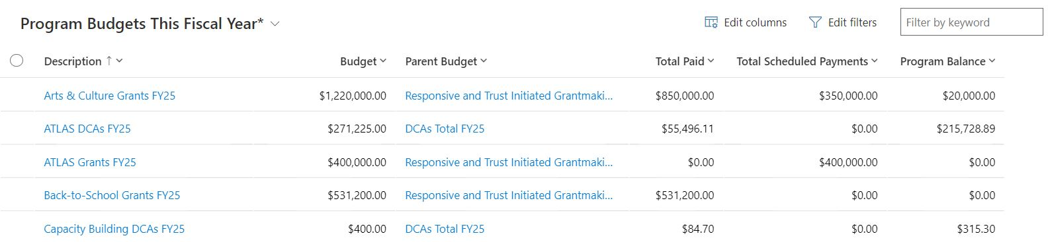
PIPER TRUST PROGRAM BUDGETS
Notes:
Not Program Related - Tracks the Entire Grants Budget by Budget Line for Each Fiscal Year. Each Year, after approved budget, we create new budget lines so staff can track various line items without access to accounting software. If you export every entry in the program budget, it would add up to our $28.7m budget.
Concepts - We then use Concepts to track Big Ideas – Future Grants – there is a payment stream attached to each active concept - possible pipeline.

Slide 11
PLANNING YOUR VISUALIZATION
(THE REPORT)
Types of Visualizations for the Report:
    Card (Big! Uncommitted $$)
    Pie Chart (Show the Pieces of Paid, Scheduled, Remaining)
    Gauge (How close am I to using the remaining budget with my forecasted/pipeline grants).
Notes:
Other considerations?
Will it ever be used externally (branded or unbranded). Example – Trustee use.
Do I need to consider individuals with visual impairment? Color blindness etc.

Slide 12
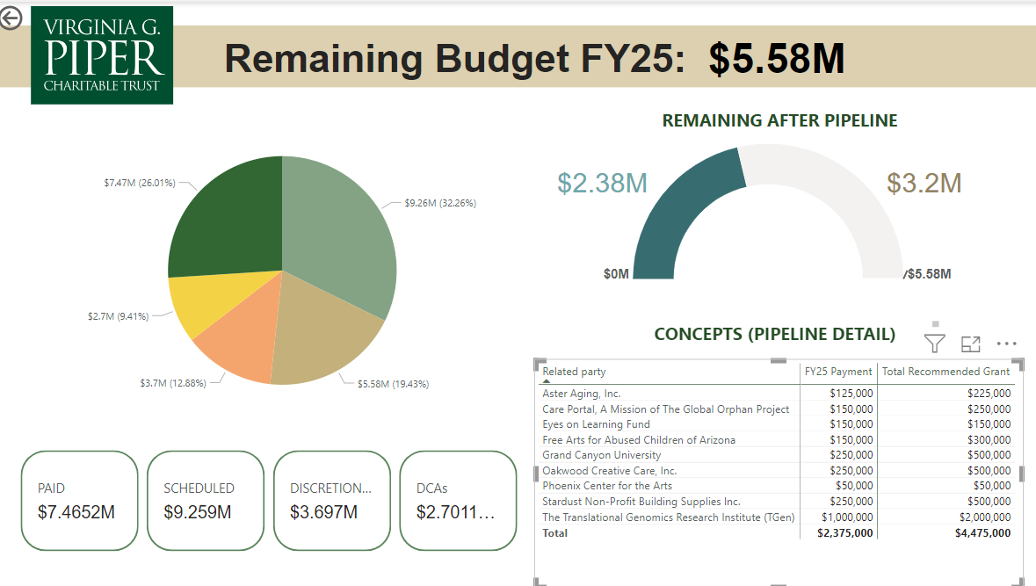
Building It!
Notes:
Other considerations?
Will it ever be used externally (branded or unbranded). Example – Trustee use.
Do I need to consider individuals with visual impairment? Color blindness etc.

Slide 13
APPLYING CONCEPTS
  What do we want? High-level overview of Giving
  Whose it for?
      Executive team
  What are we examining?
      Program Core Areas/Geography
          Where is this in akoyaGO?
      How are we showing it?
          Card, Charts, Map

Slide 14
PUBLISHING TO akoyaGO
In app.powerbi.com, pin your new report to a dashboard
In akoyaGO – new for 2024, ALL users need to have a license to view their versions of the dashboard
In CRM, navigate to Dashboards > +New > New PowerBI dashboard
Select the new Dashboard that appears in the akoyaGO workspace

Slide 15
RESOURCES
Microsoft Learn: Choose Learning Paths, Power Platform (Power BI is part of the Power Platform):
Suggested:
Get Data with Power BI desktop
Get started building with PowerBI
Explore fundamentals of data visualization
Notes:
.

Slide 16
PRESENTED BY
Tyler Long
Manager of Technical Services
Kelly Matti
Director of Grants Management
Virginia G. Piper Charitable Trust
Kmatti14@gmail.com
THANK YOU

