Slide 1



Share your photos to
the conference album!
#EMPOWERED2024

Slide 3
COMMUNICATIONS BETWEEN CRM AND BUSINESS CENTRAL
PRESENTED BY
Meghan Davignon | Director of Product

Slide 4

COUPLING AND SYNCHRONIZING
Coupling and synchronization between CRM and Business Central

Slide 5
COUPLING
Coupling: When a record in CRM (Dataverse) is linked to a record in Business Central.
Grantee vendors and Donor customers are automatically created in Business Central and coupled.
Funds, Departments, Functions, and GL Accounts are also automatically coupled and synchronized upon creation.

Slide 6
SYNCHRONIZATION
Once a record is coupled, data changes can be synchronized between systems.
Data changed in CRM is synchronized immediately on save.
Data changed in Business Central is synchronized every five minutes.
*Posted Payment and Deposit data is synchronized immediately upon posting.
akoyaGO CRM |  | Business Central
Constituents/Contacts/Donors |  | Vendors/Customers/ Contacts
Accounts |  | Accounts
Account Subcategory |  | GL Acct Subcategories
Departments |  | Departments
Funds |  | Funds
Fund Net Assets |  | Fund Balance
Functions |  | Functions
Request Payments |  | Payments
Gift Payments |  | Deposits

Slide 7
VENDORS/PAYEES
Constituents become Vendors/Payees in Business Central when:
A Request is approved where they are set as the Payee
The “Is Vendor” field is toggled to Yes
Contacts become Vendors/Payees in Business Central when:
The “Is Vendor” field is toggled to Yes
Data sent to Vendor profile:
Name, Address, Phone, Email, Tax ID (Constituent only), Status

Slide 8
CUSTOMERS/DONORS
Constituents/Contacts become Donors/Customers in Business Central when:
A Gift is created where they are the Donor Constituent (Organization Donors) OR the Primary Donor Contact (Household Donors)
The “Is Customer” field is toggled to Yes
Data sent to Vendor profile:
Name, Address, Phone, Email, Status

Slide 9
REQUEST PAYMENTS
Key fields used during the Send to Accounting process

Slide 10
REQUEST PAYMENTS
Data Sent from CRM to Business Central
Payee: Vendor to whom the check/EFT is made payable.
Posting Date: When the expense/payable is accrued.
Est. Grant Pay Date: Due Date for the vendor payment in BC. If blank, defaults to Posting Date.
Fund/Department/Function: Dimensions assigned to the expense
Account: G/L Account assigned to the expense
Payable Account: G/L Account which holds the payable balance (from accounting settings)

Slide 11
REQUEST PAYMENTS
GL Memo v. Posting Description
GL Memo transfers to the Memo field in Business Central’s GL Entries. The memo is often used for external-facing reports/views (e.g. Fund Statement detail). The default value is the Request Applicant unless it is blank, then Primary Contact is used (scholarships)
Posting Description transfers to the Description field in Business Central’s G/L Entries. This is usually what prints on a check stub.

Slide 12
REQUEST PAYMENTS
Data sent from Business Central to CRM
Payment Date: The posting date of the payment issued from Business Central
Payment Account: The asset account (bank account) from which the item was paid
Check #: The Document No. of the payment; if a check was printed, the check number, if EFT, the generated document number.
Clear Date: The date of the Bank Statement on which the item was marked cleared

Slide 13
GIFT PAYMENTS
Key fields used during the Send to Accounting process

Slide 14
GIFT PAYMENTS
Data Sent from CRM to Business Central
Payor: Customer to whom the receivable is attributed
Posting Date: The date the revenue/receivable is accrued
Check Date: Document No. used on the GL Entries (if blank, Payment Type is used)
Fund/Department/Function: Dimensions assigned to the revenue
Account: G/L Account assigned to the revenue
Receivable Account: G/L Account which holds the receivable balance (from accounting settings)

Slide 15
GIFT PAYMENTS
GL Memo v. Posting Description
GL Memo transfers to the Memo field in Business Central’s GL Entries. The memo is often used for external-facing reports/views (e.g. Fund Statement detail). The default value is the Gift Formal Acknowledgement
Posting Description is not defined on the Gift Payment record. Description in GL Entries defaults to the gift serial number (GPMT-)

Slide 16
GIFT PAYMENTS
Data sent from Business Central to CRM
Deposit Date: The posting date of the deposit posted in Business Central
Deposit Account: The asset account (bank account) into which the deposit was made
Clear Date: The date of the Bank Statement on which the deposit was marked cleared

Slide 17
FUND FEES
How CRM and BC work together to calculate fund fees

Slide 18
FUND FEES
akoyaGO CRM | Business Central
Fund Fee Formula(s) | Fund Balances
Fund attributes*: Status (Active) Fee Calculation Basis Fee Percent Fee Amount Alternate Fund Fee Fund
Accounting Settings: Operating Fund
*Fund Fee Formulas are highly configurable and unique to each client. Additional Fund attributes may be referenced in the formula.

Slide 19
SPENDABLE ALLOTMENT
How CRM and BC work together to calculate spendable allotment

Slide 20
SPENDABLE ALLOTMENT
*Spendable Allotment Formulas are highly configurable and unique to each client. Additional Fund attributes may be referenced in the formula
akoyaGO CRM | Business Central
Spendable Allotment Formula(s) | Fund Balances
Fund attributes*: Status (Active) Spend Percent Spendable Amount Alternate Spendable Fund

Slide 21
JOINT INVESTMENT ALLOCATION
How CRM and BC work together to JIA

Slide 22
JOINT INVESTMENT ALLOCATION
Joint Investment Allocation is assessed to any active fund not excluded from the process.
*DT Accounts are not directly used during JIA
akoyaGO CRM | Business Central
Fund attributes: Status (Active) Exclude from JIA | Fund Balances

Slide 23
ACCOUNTING SETTINGS
Default values and functions managed from accounting settings

Slide 24
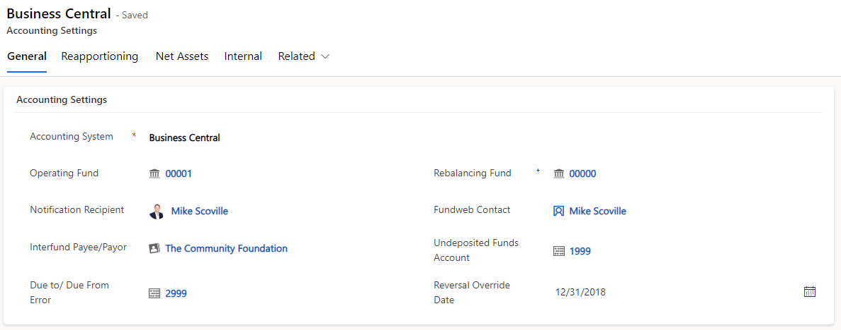
ACCOUNTING SETTINGS

Slide 25
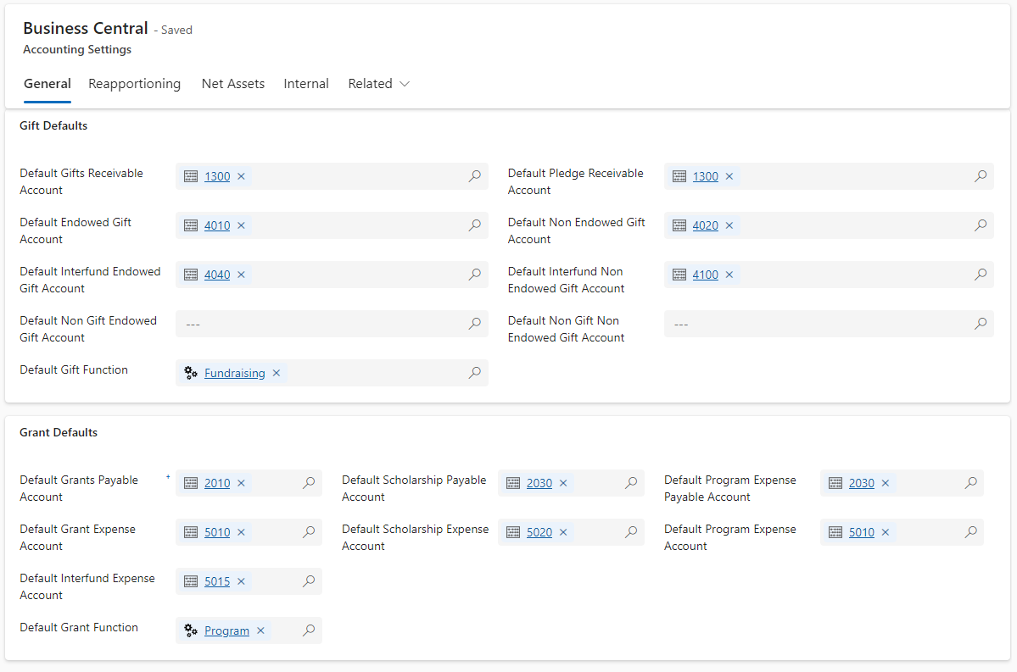
DEFAULT ACCOUNTS
Default accounts are used when creating gift and request payments in CRM

Slide 26
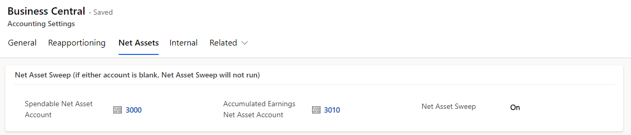
NET ASSET SWEEP
*Net Asset Sweep only runs for funds not marked as endowed

Slide 27
AUTOBALANCE
DT Accounts: Where the fund assets belong
Fund Status (Active): Auto balance only runs for Active funds
Reapportion From: Auto balance will not run before the Reapportion From date
Allow Posting From: The minimum posting date for any transaction

Slide 28
PRESENTED BY
Meghan Davignon
Director of Product
THANK YOU

