Slide 1



Share your photos to
the conference album!
#EMPOWERED2024

Slide 3
GOfund FEATURES AND FUNCTIONS
PRESENTED BY
Alyson Belvin | Director of Client Services Chelsey Wagoner | Manager of Client Experience

Slide 4

GOfund
Implementation
Inviting Fundholders
Grant Recommendations
Fund Statements
Documents
Donations
Live Examples
OBJECTIVES

Slide 5
WHY GOfund?
Self Service Portal for Fund holders
    Simple User Interface (UI)
Eliminate/ reduce printing of Fund Statements
Quick access to fund activity and history
    Real time data
Online processing of grant recommendations
Transparency
Document Sharing

Slide 6
IMPLEMENTING GOfund
Prepare
Review Fund Details
Determine fund information to share online
Setup
Complete GOfund Settings
Test Fund Connections
Communicate
Share the upcoming changes with fundholders
Prepare a user guide or help plan for fundholders
Launch
Work with akoyaGO for bulk invites
Support fundholders post-live
Notes:
Show – GOfund settings, Fund Record

Slide 7
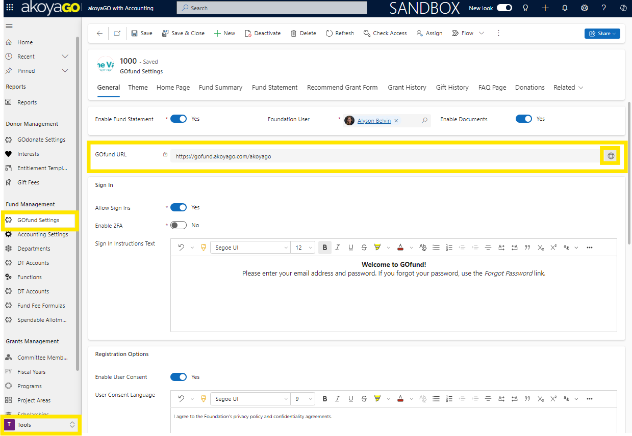
SETTINGS
Notes:
Walk through a connection in GOfund - https://akoyago.crm.dynamics.com/
Login to Demo, Pick a fund, make a contact for Chelsey, test login

Slide 8
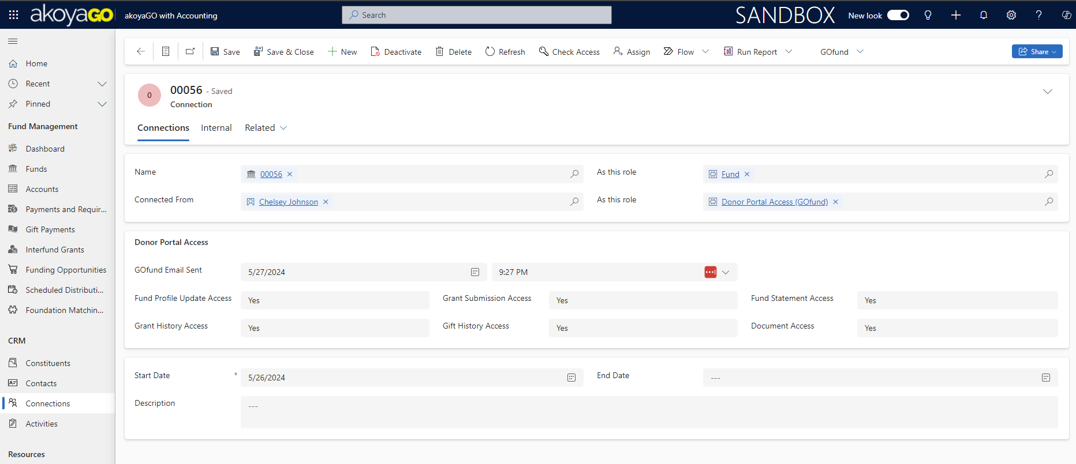
CONNECTIONS
Tips
Donor Portal Access (GOfund)
Email Sent Date auto-fills
Change default permissions
Start date = invite date
Programming occurs upon save
Notes:
** This has been programmed so no more FLOWS! Very quick response and tracking tools in timeline.
Walk through a connection in GOfund - https://akoyago.crm.dynamics.com/
Login to Demo, Pick a fund, make a contact for Chelsey, test login. Active Aging Fund >> Chelsey Wagoner >> Donor Portal Connection

Slide 9
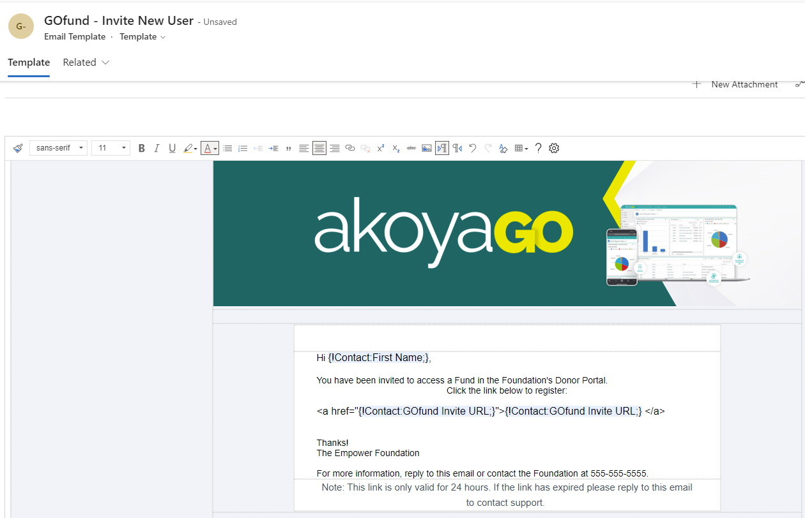
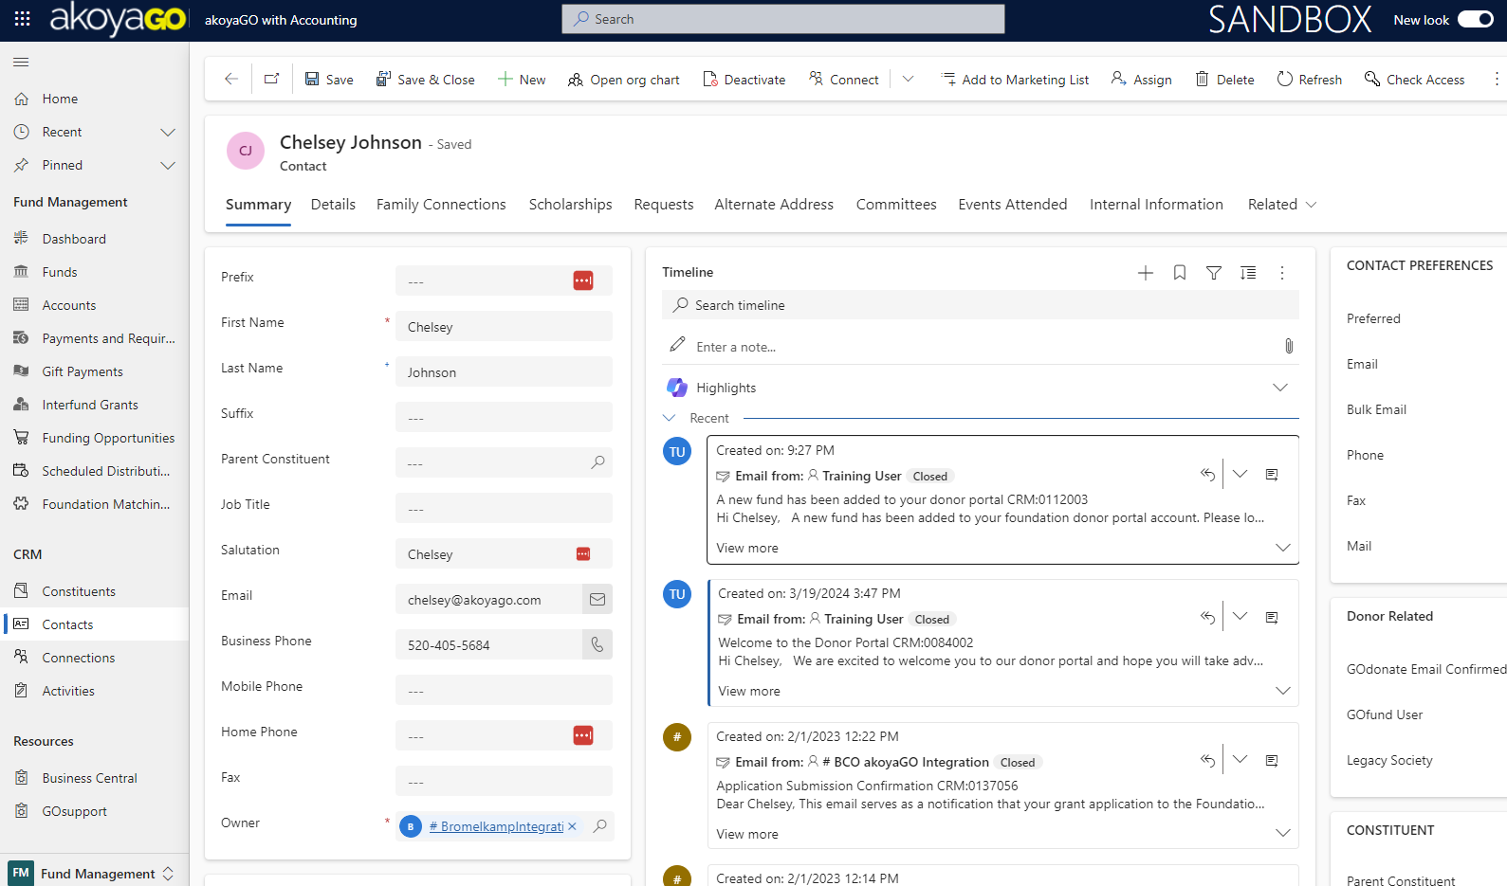
Create GOfund Connection in CRM
Invitation Email sent to fundholder
Fundholder's GOfund Activity logged in CRM
Support fundholder's with impersonation tool
Update GOfund settings as needed
INVITING FUNDHOLDERS
Notes:
GOfund Connections View
Email Template

Slide 10
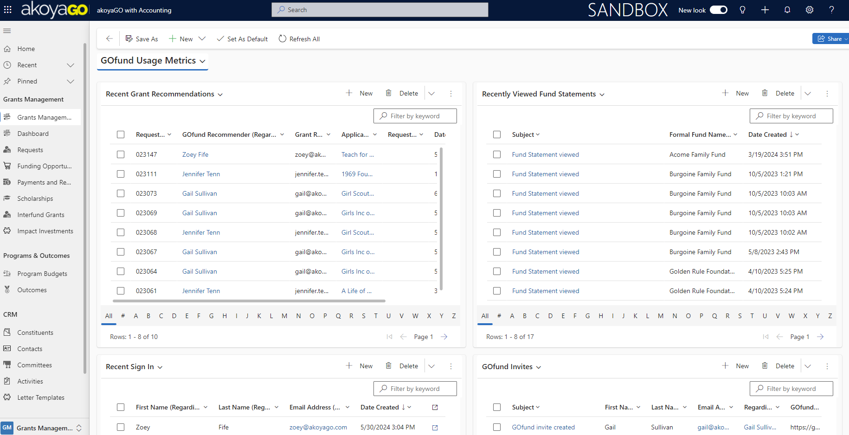
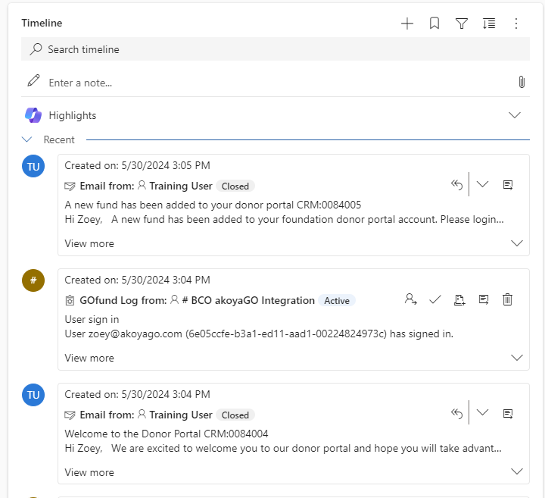
TRACKING USER ACTIVITY
Notes:
Fundholder activity is tracked with GOfund logs, which are displayed as activities on the contact timeline record. We also have a system Dashboard to display this information for all GOfund users together

Slide 11
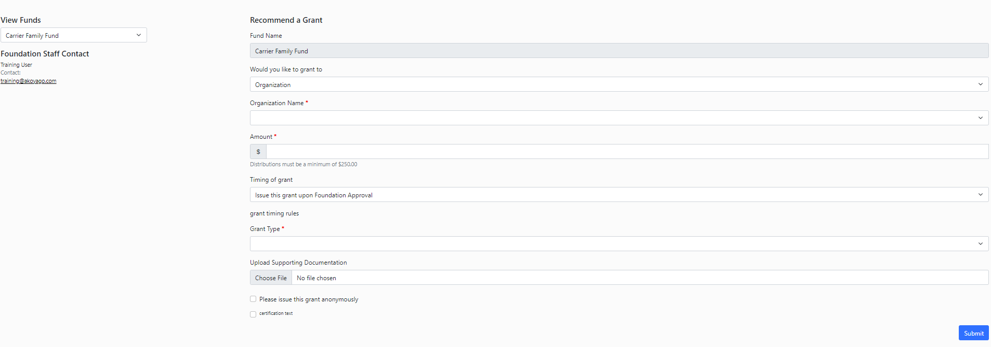
Login to GOfund
Select Fund to make a recommendation from
Select an organization or interfund to recommend to
Complete recommendation form and submit
Receive a confirmation email after processed
GRANT RECOMMENDATIONS (UI)
Notes:
Priority Feature: Customizable Recommend a Grant Form
Login as a user: https://gofund.akoyago.com/akoyago

Slide 12
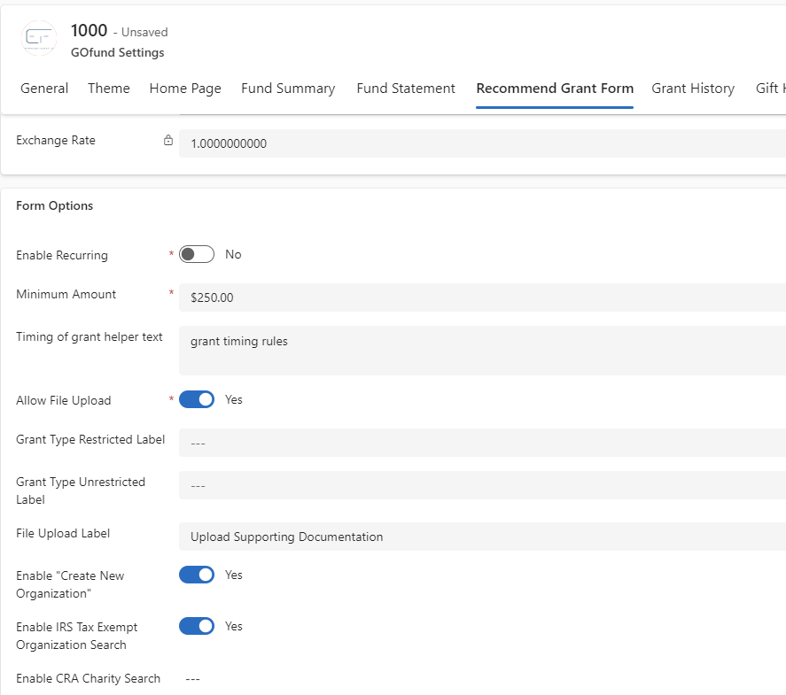
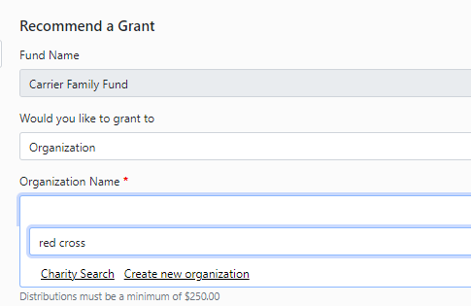
CHARITY SEARCH / NEW ORGS
Notes:
Charity Search
GOfund Settings
Duplicate management
What changes have we made based on client feedback?

Slide 13
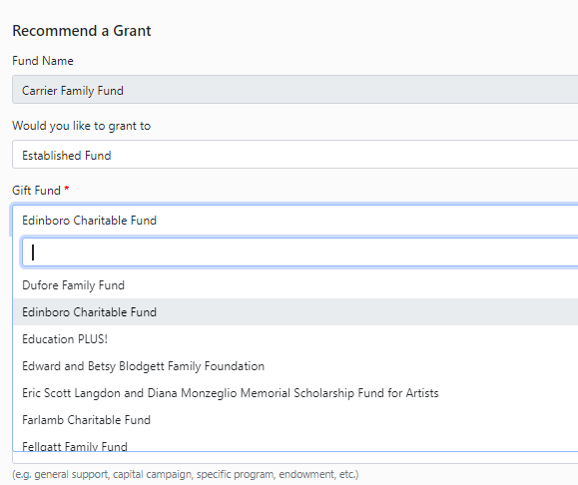
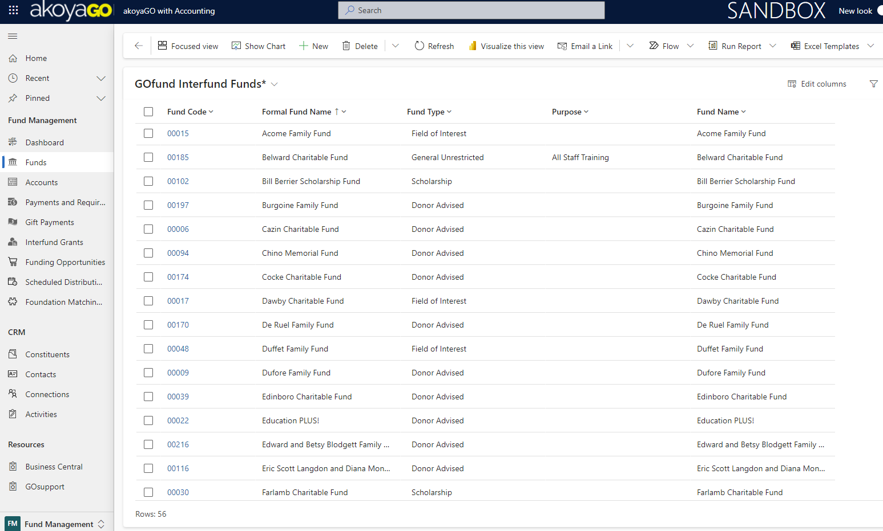
INTERFUNDS
Notes:
Established fund = Interfund
Determine which funds display = GOfund Interfunds View

Slide 14
PROCESSING REQUESTS
Recent Recommendations View in GOfund Usage Metric
Request # Assigned
GOfund Recommender
Fundholder Verified
Process request as usual

Slide 15
SYSTEM VIEWS AND DASHBOARDS
Current System views recommended for managing GOfund tasks:
All GOfund Requests
    Based on a view on Requests called All GOfund requests
Grant History
    Based on a view on Payments and Requirements called GOfund Grant History
Gift History
    Based on a view on Gift Payments called GOfund Gift History
GOfund Gift Export view/ GOfund Grant Export view
    Based on a view in the Gift Payments entity called GOfund Gift Export View
    Based on a view on the Payments & Requirements entity called GOfund Grant Export view

Slide 16
SYSTEM VIEWS AND DASHBOARDS
Current System views recommended for managing GOfund tasks:
GOfund Grant Recommendation Eligible Constituents
    Based on a view on Constituent called GOfund Grant Recommendation Eligible Constituents
Exclude/Include Funds
    Based on a view on Funds called GOfund Interfund Funds
GOfund Usage Metrics Dashboard

Slide 17
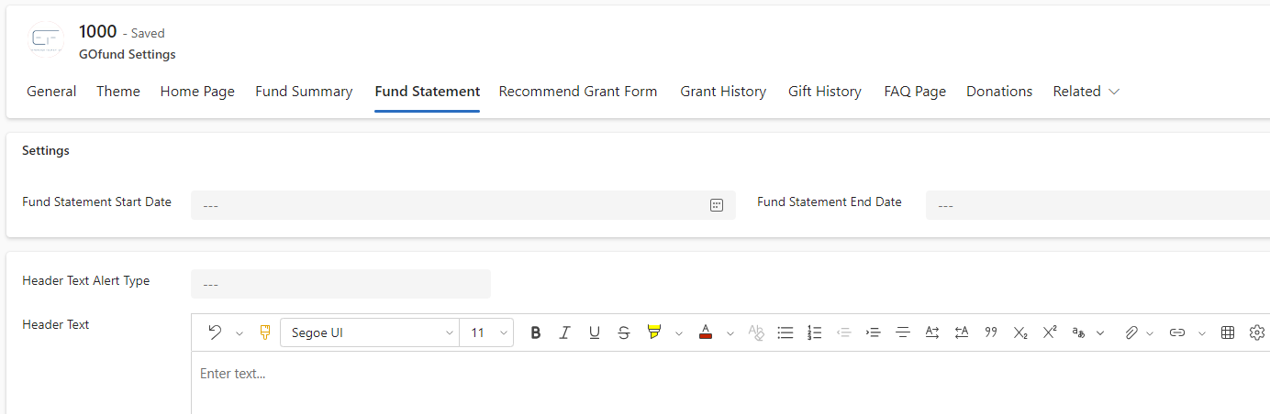
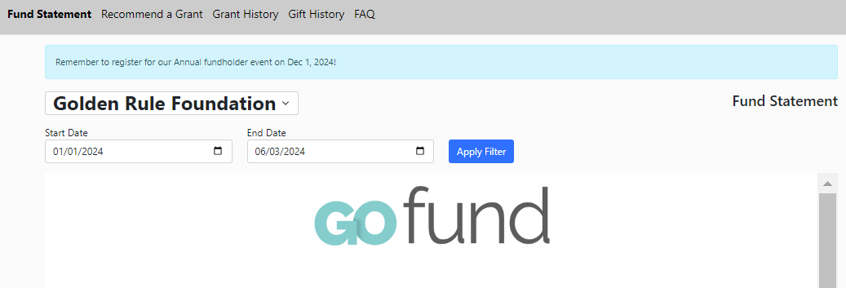
FUND STATEMENTS
Notes:
Gofund Settings – start and end date
GOfund Default programming – in GOfund you will see the default start YTD. You can now add header text

Slide 18
DOCUMENTS
Global
Upload in GOfund Settings
Displays for all GOfund Users as a shared document
Fund Specific
Upload in Fund record, Documents
Displays for fundholder(s) with active connection to that fund where "Document Access" permission is set to "Yes"

Slide 19
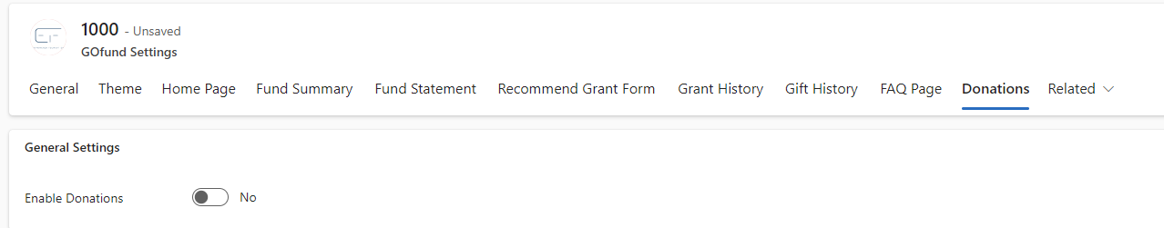
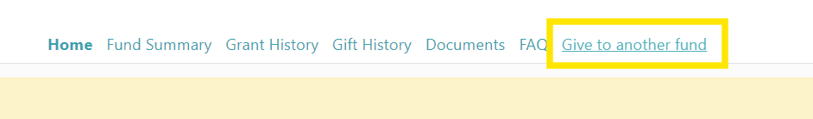
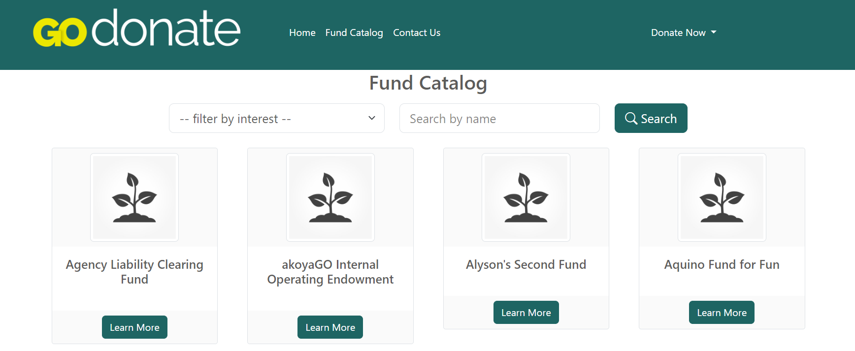
DONATIONS

Slide 20
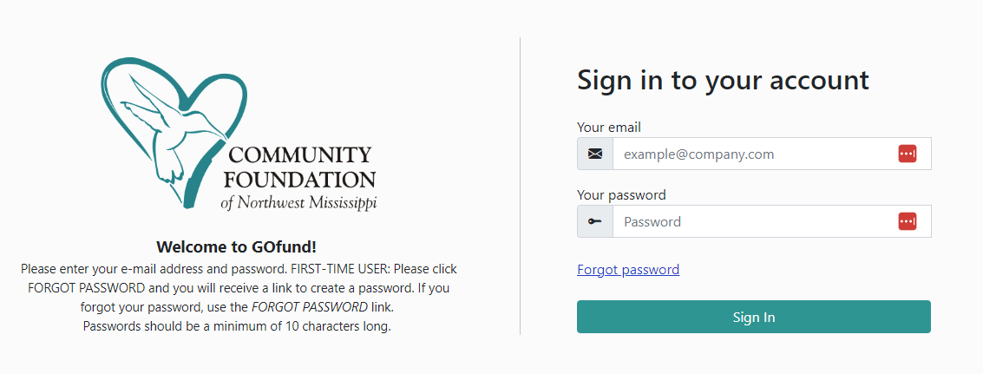
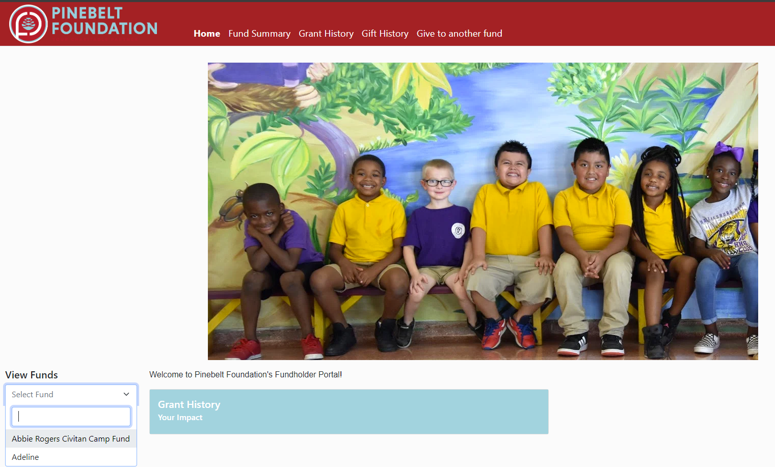
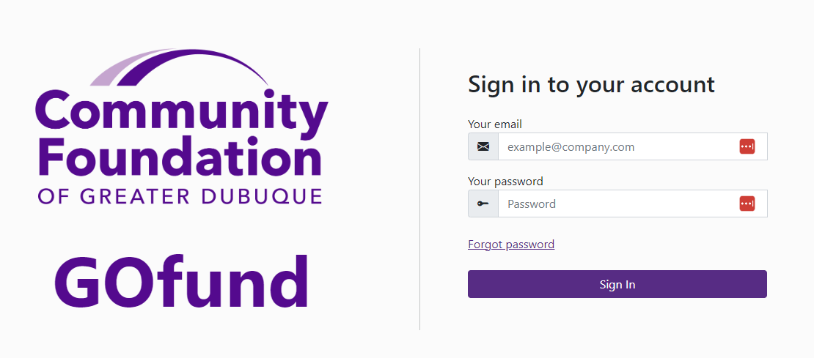
USER EXAMPLES

Slide 21
COMING SOON
Modifications to the GOfund Recommend a Grant Form
Increased filtering for reporting on recommended grants (i.e. grants awarded by city, county, etc. for funding metrics)
Filter and sorting options for all columns on the grant history tab such as ascending/descending, high/low
Shopping cart experience for grant recommendations | 2025

Slide 22
QUESTIONS?

Slide 23
RESOURCES
Adding Connections for GOfund Users
GOfund Admin Guide
    Connections, Settings, Funds Included, GOfund User Interface
GOfund Implementation – Suggested Learning Course
    Testing Checklist, FAQ, Stripe Setup
Notes:
GOfund Admin Guide
Adding Connections for Gofund users
GOfund Implementation – suggested learning course

Slide 24
PRESENTED BY
Chelsey Wagoner
Manager of Client Experience
Alyson Belvin
Director of Client Services
SUPPORTING PRESENTER
Addie Kelzer
Account Manager
THANK YOU

