Slide 1



Share your photos to
the conference album!
#EMPOWERED2024

Slide 2
Notes:
bookends
start:
Why this is important
Things to keep in mind
my data is safe (backups), how often (Best practice)
Data protection
Re-iterate Date Dup
Custom Fields Best Practices
over customizing is not good for you
can cause upgrade issues
its a fine line you can walk
no random text fields
think ahead, what output do you want?
Have a goal before you start
Ideas (Josh's pro-tips):
Data clean up day
Clean up jobs
Josh does his thing
end: QA

Slide 3
DATABASE MAINTENANCE
AND DATA POLICY SESSION
PRESENTED BY
Paul Czywczynski | Chief Technology Officer
Josh Jaeger | Database Administrator |
The Erie Community Foundation

Slide 4
WHY IS DATA MAINTENANCE IMPORTANT?
“Data maintenance is vital for charity foundations to ensure accurate records, streamline operations, and effectively serve our donors and beneficiaries.
Proper data management helps us maintain trust, improve efficiency, and fulfill our mission more effectively.”
− ChatGTP

Slide 5

Data Safety
Data Quick Tips
Deep Dive: Data Policy
AGENDA

Slide 6
DATA SAFETY
Backups
Microsoft automatically retains 28 days of history
Test, test, test your backups
Resource
Encryption
Dynamics/akoyaGO is security while in transit and at rest
Don’t forget your workstation (Lock your computer, BitLocker)
Resource #1, Resource #2

Slide 7
DATA SAFETY
Auditing
  “Dynamics 365 data auditing is a feature that tracks and logs changes made to data within the system. It helps monitor who made changes, what was changed, and when the changes occurred.”
  Resource #1, Resource #2
Record Recycle Bin (Preview)
“Recycle bin is available to recover table record data from any type of delete scenario within a specified configurable time frame.”
Resource

Slide 8
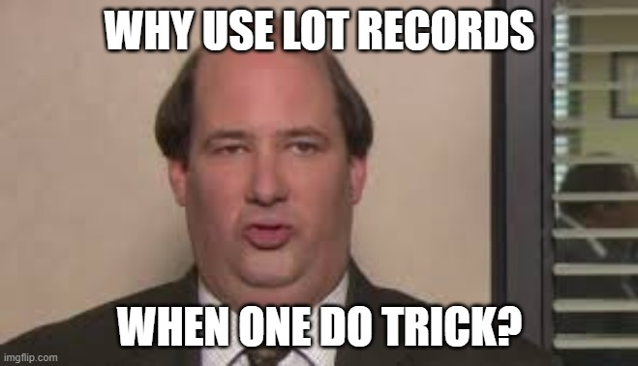
DATA QUICK TIPS
Custom Fields
Over-customizing adds complexity and can cause future update issues
Don’t go overboard, think ahead, what output do you want? What is your goal?
Be specific with your data types, avoid random text fields
Data De-duplication
Adapt the rules to your needs
Have a data clean-up day
Resource

Slide 9
Garbage In = Garbage Out
BUT
Pennies In = Dollars Out!
DATA POLICY

Slide 10
DATA ENTRY STANDARDS
Documentation
Internal vs. External Resources
Implementation and Monitoring
Josh's Best Practices

Slide 11
DOCUMENTATION − INTERNAL
  Process Documents
  Data Dictionary
  Wiki
  Others (old emails, templates, etc.)?

Slide 12
DOCUMENTATION − EXTERNAL
  GOsupport
  Microsoft Learn
  DUG
  Others? (your developer friend, Reddit, etc.)

Slide 13
DOCUMENTATION − WHAT IS A DATA POLICY MANUAL?
What a Data Policy Manual Is/Contains:
    Is:
        "The Single Source of Truth“
    Contains:
Empathy | Purpose
General Guidelines and Best Practices | Vision for document evolution
Policy Definitions | Data Dictionary (for "Earth People")
Process Definitions | Empowerment

Slide 14
DOCUMENTATION – WHAT IS NOT A DATA POLICY MANUAL
What a Data Policy Manual IS Not/Does Not Contain:
    IS NOT:
          Instruction manual for akoyaGO, BC, PowerApps, PowerAutomate, Microsoft Office 365, etc.
    Does Not Contain:
          People's Names
          Unenforceable ("Try to...") Policies
          Unreasonable Expectations

Slide 15
DOCUMENTATION – DATA POLICY MANUAL
  How to Create a Data Policy Manual:
    Get Leadership Buy-in
        If you don't have it, stop here.
    Stand on the shoulders of giants
        Steal somebody else's manual!
    Do the work inclusively (but work ahead)
        Standing meetings...the best way to eat an elephant?

Slide 16
IMPLEMENTATION AND MONITORING
  Empower your team!
  Audit. Everything.
  Generate Error Views/Dashboards.
  Leverage leadership buy-in.

Slide 17

IMPLEMENTATION AND MONITORING
  Empower your team!
    Establish Data Ownership
    Leverage Data Democracy
    Create Data Deputies!

Slide 18
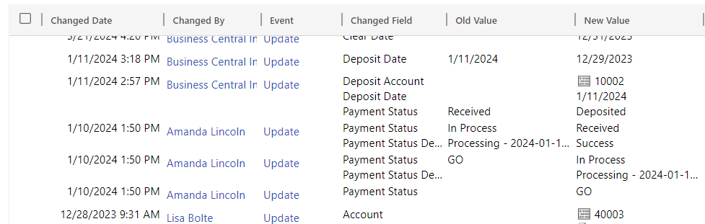
IMPLEMENTATION AND MONITORING
  Audit. Everything.

Slide 19
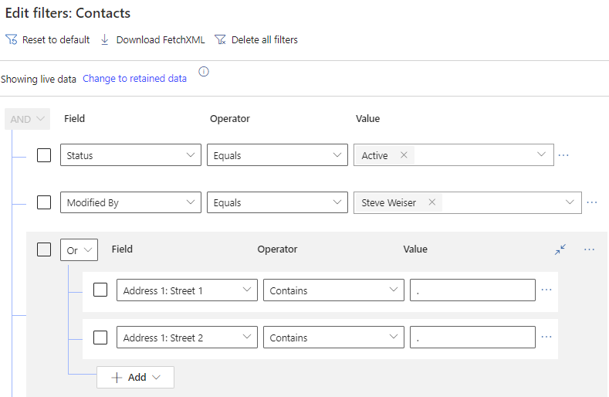
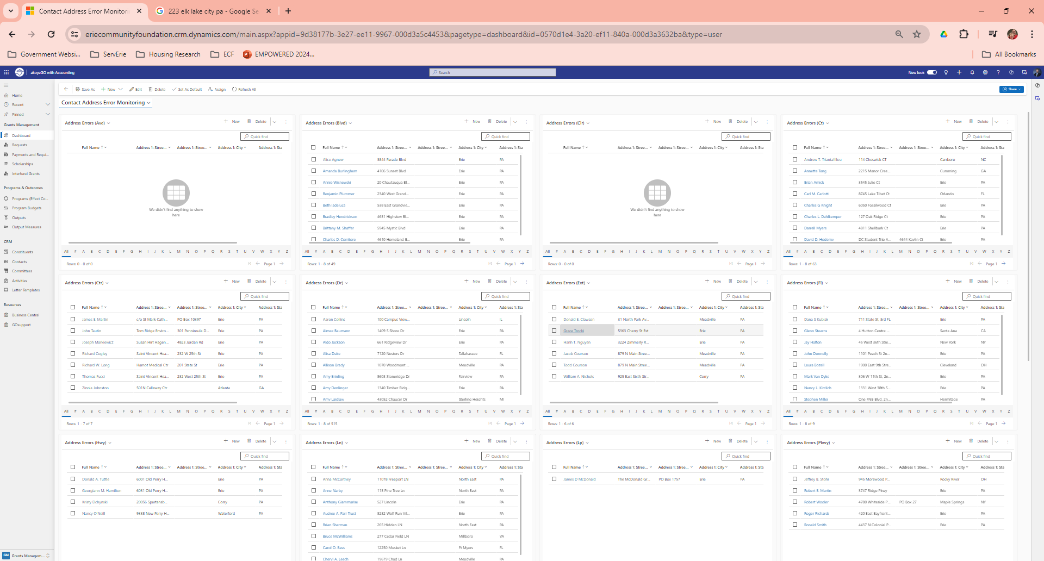
IMPLEMENTATION AND MONITORING
  Generate Error Views/Dashboards

Slide 20
IMPLEMENTATION AND MONITORING
Leverage leadership buy-in
    Establish a standing meeting with department heads (weekly, bi-weekly, monthly, etc.)
    Go over reports/dashboards
    Establish timelines for correction
        Be flexible on timelines

Slide 21
PRO TIPS
Leave space at the end of each meeting for support ("How can I make your life easier?").
Make it about the data.
    Communicate the value of data quality.
GOappreciate!
    Look for and celebrate the wins early and often.
**Tie system changes to documentation changes.**

Slide 22
PRESENTED BY
Paul Czywczynski
Chief Technology Officer
Josh Jaeger
Database Administrator |
The Erie Community Foundation
Jjaeger@eriecommunityfoundation.org
THANK YOU

