Slide 1



Share your photos to
the conference album!
#EMPOWERED2024

Slide 3
TAILORING THE STAFF EXPERIENCE IN POWER APPS
PRESENTED BY
Joe McCray | Technical Services Consultant

Slide 4

UI/UX: The Secret Sauce to CRM Success
Business Rules Vs Processes
The Benefits of Good UI/UX in CRM
Optimizing UI/UX and Streamlining Processes for Foundations

Slide 5
The Look and Feel: Decoding UI
The User Journey: Mastering UX
Understanding the Staff Experience
UI/UX: THE SECRET SAUCE TO CRM SUCCESS

Slide 6
THE LOOK AND FEEL: DECODING UI
The visual design: Layout and Imagery
Interactive elements: Buttons, Help Text, Forms
Overall aesthetic appeal: How easy it is to navigate the CRM

Slide 7
THE USER JOURNEY: MASTERING UX
How easy it is to complete tasks: Intuitive workflows, clear instructions
How users feel while using the CRM: Frustration, satisfaction, engagement
The overall value provided: Does the CRM help users achieve their goals efficiently?

Slide 8
UNDERSTANDING THE STAFF EXPERIENCE
Prioritize features that matter to your team.
Customize fields that help achieve your goals
Regularly gather feedback to ensure the system evolves with your needs.

Slide 9
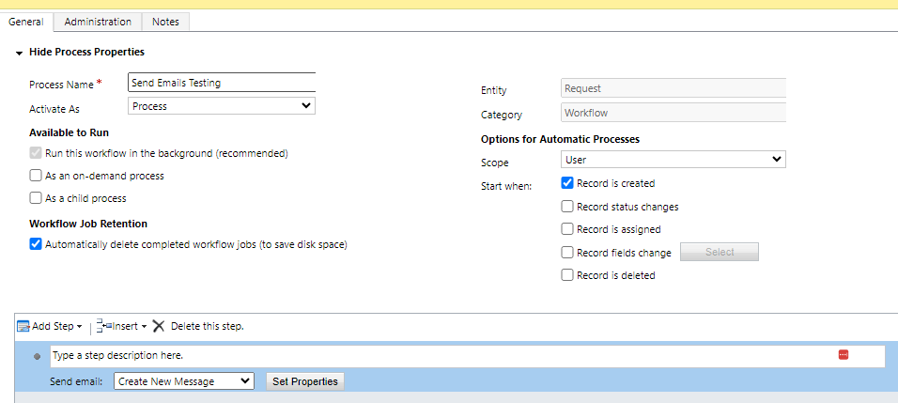
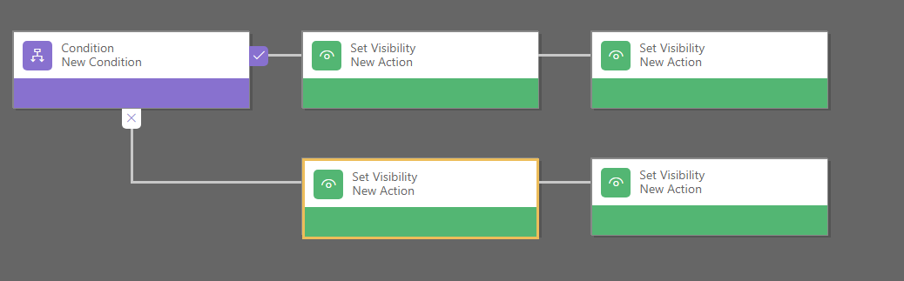
BUSINESS RULES
VS
PROCESSES

Slide 10
BUSINESS RULES IN DAY-TO-DAY WORK
Feature | Example | Benefits
Automatic actions that happen in the background when certain conditions are met. They help ensure data consistency, accuracy, and guide user interactions. | Your foundation has Grant and Scholarship opportunities, and your foundation has different types of grant Programs (e.g., Animal-related, Arts and Culture, Diversity). Showing Budget FY and Budget Line Item when Program field is populated as well as making them required. | Staff can trust the data in the CRM and focus on their core responsibilities without worrying about data inconsistencies.

Slide 11
PROCESSES IN DAY-TO-DAY WORK
Feature | Example | Benefit
A series of steps that define how work gets done. They automate tasks, guide users through complex procedures, and ensure consistency in how things are handled. | Multi-step approvals: Step 1: Grants Manager reviews the request and provides initial approval. Step 2: Finance staff reviews the budget and provides financial approval. Step 3: Request is automatically routed to the board for final approval. | Enhanced Transparency: The process tracks the progress of each request. Improved Communication: Automatic notifications keep everyone involved informed of the request's status. Reduced Manual Effort: Eliminates the need for staff to manually track and route requests.

Slide 12
BUSINESS RULES VS PROCESSES
Feature | Business Rules | Processes
Complexity | Low | Medium to High
Execution | Real-time | Real-time or Background (scheduled)
Actions | Single action | Multiple actions
Entities | Single entity | Multiple entities
Customization | Limited to available actions and conditions | More extensive customization options
Examples | Field updates, calculations, visibility changes | Approval workflows, lead nurturing, opportunity management

Slide 13
Improve Efficiency and Productivity
Reduce Errors and Frustration
Tailor the System to your Foundation’s Needs
THE BENEFITS OF GOOD UI/UX IN CRM

Slide 14
IMPROVE EFFICIENCY AND PRODUCTIVITY
Eliminate tedious manual tasks with intuitive automation.
Finding information quickly
Simple workflows to reduce clicks and save time.

Slide 15
REDUCE ERRORS AND FRUSTRATION
Consistent design for easy navigation and learning.
Error prevention measures (e.g., data validation)
Clear and concise instructions to minimize mistakes.

Slide 16
TAILOR THE SYSTEM TO YOUR FOUNDATION’S NEEDS
Prioritize the features that matter most to your team.
Customize fields and dashboards for your specific goals.
Regularly gather feedback to ensure the system evolves with your needs.

Slide 17
CASE STUDY
Challenge: A Foundation, that is a mid-sized nonprofit focused on education initiatives, was experiencing high turnover among its development staff. New hires found the CRM overwhelming and difficult to navigate, leading to frustration and a steep learning curve. Experienced staff also reported feeling bogged down by the CRM's clunky interface and inefficient workflows.

Slide 18
CASE STUDY
Solution: They simplified the navigation, consolidated data into intuitive dashboards, and automate repetitive tasks like generating reports and sending donor acknowledgments.

Slide 19
CASE STUDY
Results:
Increased Productivity: Staff reported a 25% reduction in time spent on data entry and administrative tasks, allowing them to focus more on relationship building with donors
Higher Satisfaction: Employee satisfaction surveys showed a 40% increase in positive feedback about the CRM, with staff praising its ease of use and streamlined workflows.
Faster Onboarding: New Hires felt confident using the CRM within a week, thanks to the improved interface and onboarding resources. This led to a 15% decrease in new employee ramp-up time.

Slide 20
RECOMMENDATIONS
Books | Websites
The design of everyday things - Don Norman Don’t make me think -Steve Krug Laws of UX -Jon Yablonski | UXplanet - Design Sprints Learn Microsoft - UI/UX Refernce Learn Microsoft - Tests and User Feedback

Slide 21
REMEMBER
“If you think good design is expensive, you should look at the cost of bad design.”

Slide 22
PRESENTED BY
Joe McCray
Technical Services Consultant
THANK YOU

