Slide 1



Share your photos to
the conference album!
#EMPOWERED2024

Slide 3
Checks and Balances in
Business Central
PRESENTED BY
Jeffery Tenbusch | Support Tech Tier III

Slide 4
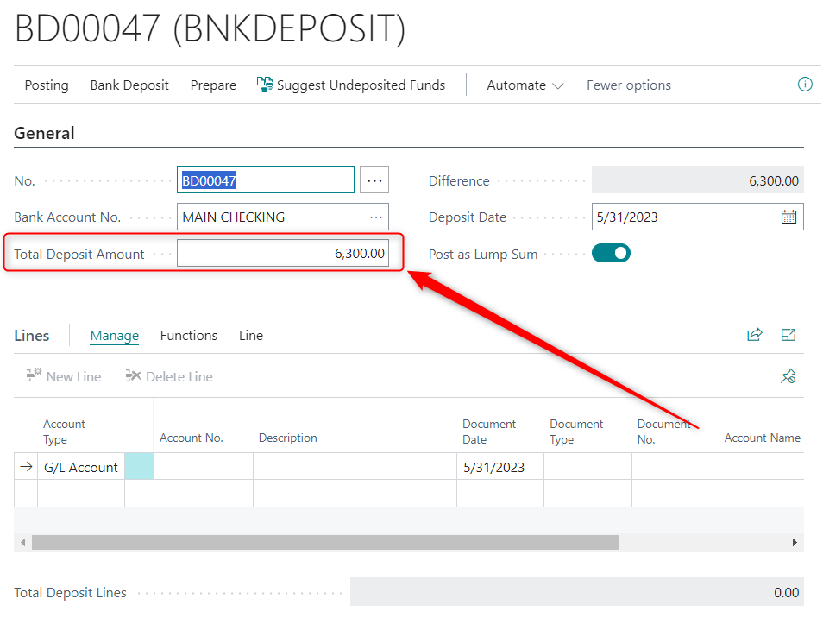
Enter Deposit Amount First
Enter the Deposit amount before suggesting undeposited funds. Either…
  Enter the total from a bank deposit slip
  Compare against the held cash and checks
Ensures the posted deposit matches the real-world deposit

Slide 5
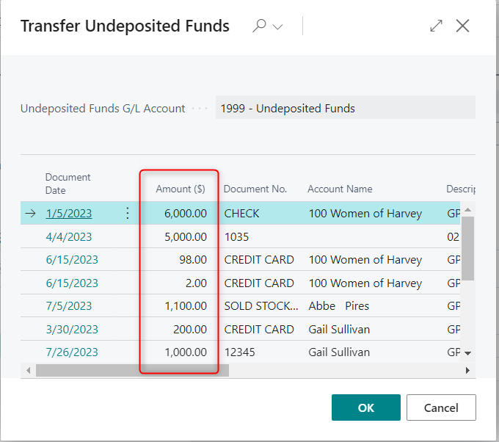
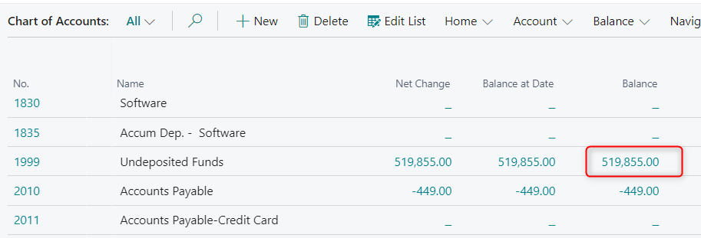
Compare Undeposited List to Undeposited Funds Balance
Notes:
Reports>General>Open Vendor Entries

Slide 6
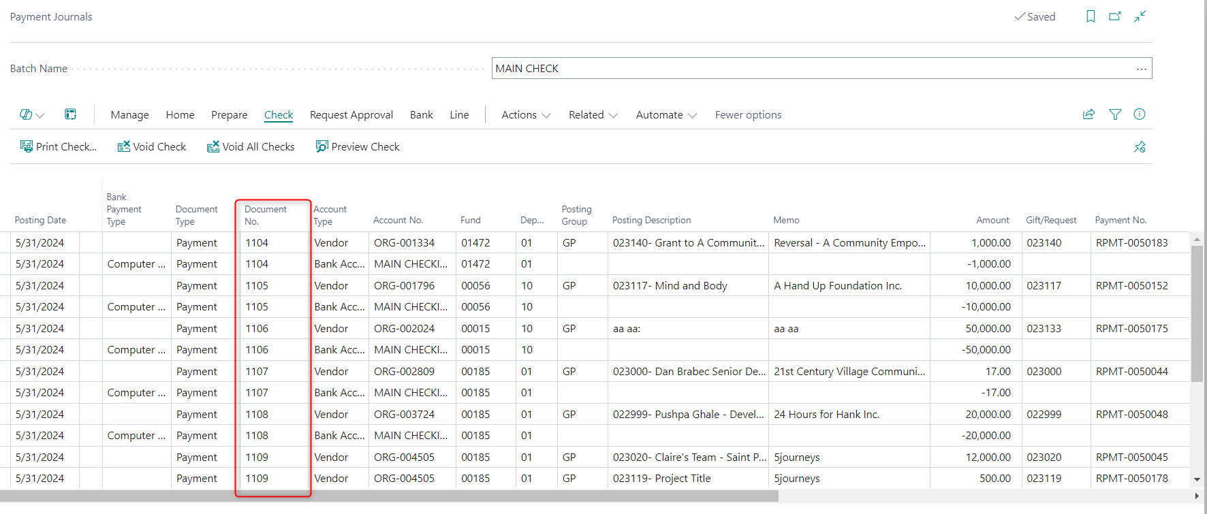
Check Payment Journal Document Numbers

Slide 7
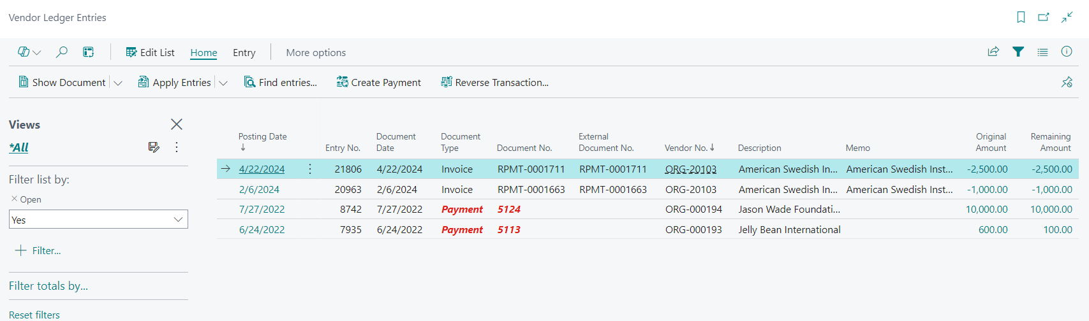
Check Open Vendor Entries
Notes:
Reports>General>Open Vendor Entries

Slide 8
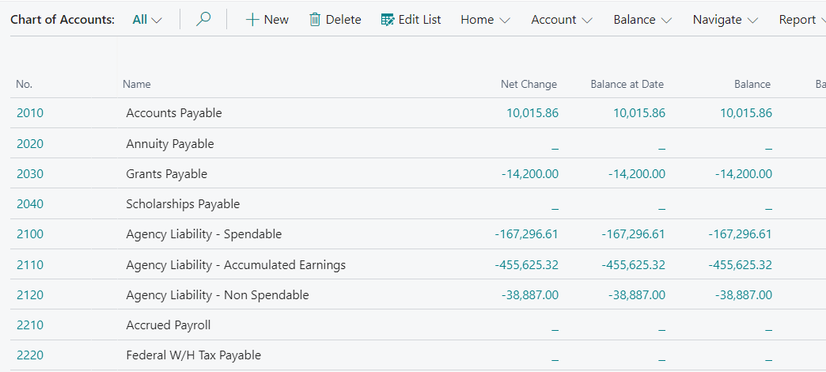
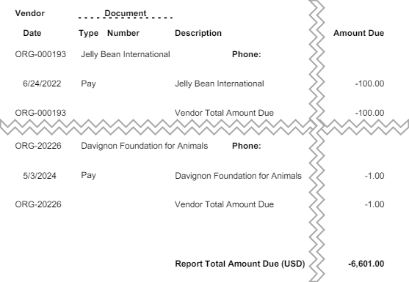
Check Vendor Balances, and compare against G/L balances
Notes:
Reports>General>Open Vendor Entries

Slide 9
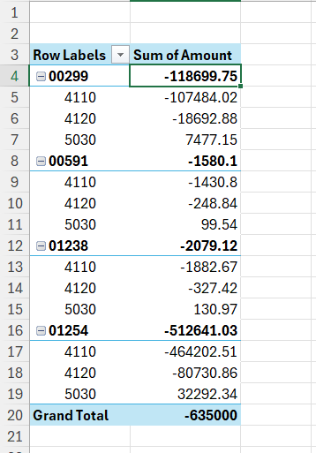
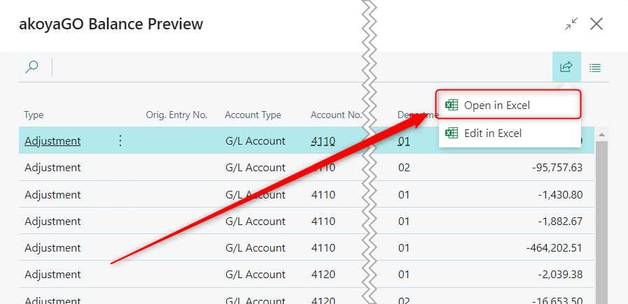
Pivot JIA Results
Notes:
Reports>General>Open Vendor Entries

Slide 10
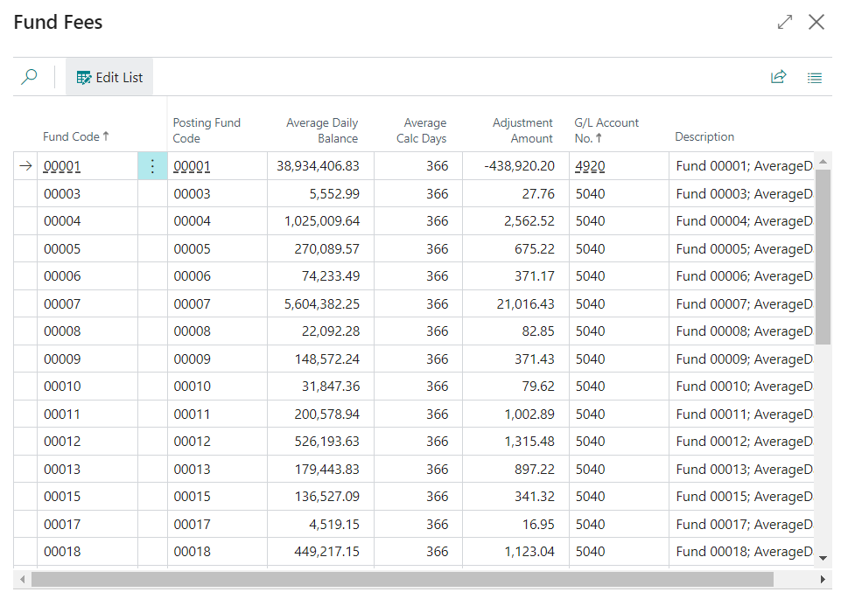
Spot check Spendable
and Fund Fees
Sort the results by Average Calc Days
Sort the results by Adjustment Amount
Select a newer fund and fund with a lot of activity to spot-check for accuracy
Notes:
Reports>General>Open Vendor Entries

Slide 11
RESOURCES
Bank Deposits - https://gosupport.powerappsportals.com/knowledgebase/article/KA-01168/en-us
Troubleshooting Undeposited Funds - https://gosupport.powerappsportals.com/knowledgebase/article/KA-01333/en-us
Managing Payables in Business Central - https://gosupport.powerappsportals.com/knowledgebase/article/KA-01453/en-us
Notes:
Reports>General>Open Vendor Entries

Slide 12
Presented By
Jeffery Tenbusch
Support Tech Tier III
THANK YOU

