Slide 1



Share your photos to
the conference album!
#EMPOWERED2024

Slide 3
akoyaGO AUTOMATIONS FOR TIME SAVING
PRESENTED BY
Claire Nyenhuis | Senior Project Manager
Notes:
https://gosupport.powerappsportals.com/knowledgebase/article/KA-01350/en-us

Slide 4

A Business Rule is a code-free way to apply conditional logic within akoyaGO.
Each business rule is associated with a single table in akoyaGO.
BUSINESS RULES
Notes:
https://learn.microsoft.com/en-us/dynamics365/customerengagement/on-premises/customize/create-business-rules-recommendations-apply-logic-form?view=op-9-1
Does not cross entities
Cover first
- similar and not similar to workflows
Convey why one over the other.

Slide 5
Set field values for consistent data: If country or region = “United States”, then set the value to “US”
Set field requirements based on data entry: If the Request Type = Scholarship, then Applicant is not required
Lock fields that should not be changed: If Request Status equals Approved, lock Decision Date and Original Grant
Show/hide fields based on data: If Request Type = Scholarship, then hide Applicant constituent field
USE CASES FOR BUSINESS RULES
Notes:
https://learn.microsoft.com/en-us/dynamics365/customerengagement/on-premises/customize/create-business-rules-recommendations-apply-logic-form?view=op-9-1
Does not cross entities
Cover first
- similar and not similar to workflows
Convey why one over the other.

Slide 6
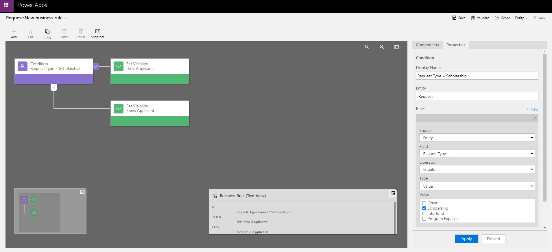
BUSINESS RULES
Notes:
Business Rules are made out of two components: Conditions and Actions.

Slide 7
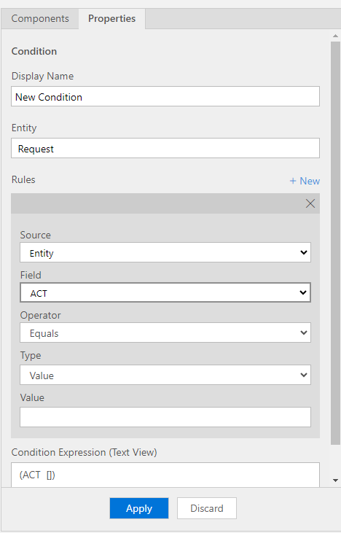
BUSINESS RULE CONDITIONS
Business Rule Conditions are the logic that defines when to apply the corresponding actions.
Create conditions by editing the Properties. Click +new to add more clauses to the logic. You can specify if it is an AND or an OR logic. Business Rules need at least one condition.

Slide 8
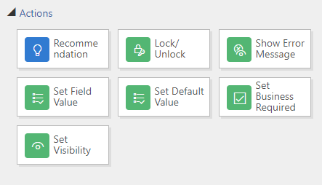
BUSINESS RULE ACTIONS
Business Rules can have one or more actions based on one condition. Actions can be applied to a single field.
Business rules can be used for the following actions:
Business rules don’t work with multi-select option sets.
Notes:
Validate/error – request type=scholarship, program = grant program
Feedback: remove text list just use image

Slide 9
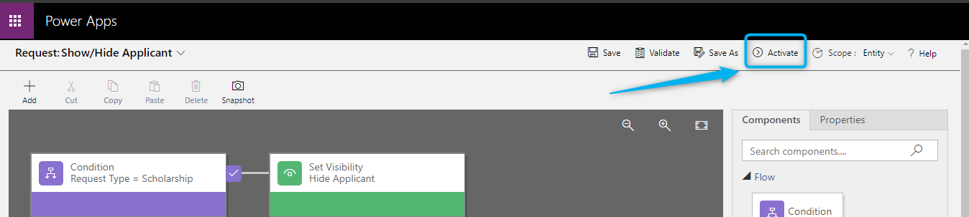
ACTIVATE BUSINESS RULES
Once the Business Rule is complete or ready to be tested, activate the rule.
Please note: Business Rules cannot be edited when activated.

Slide 10

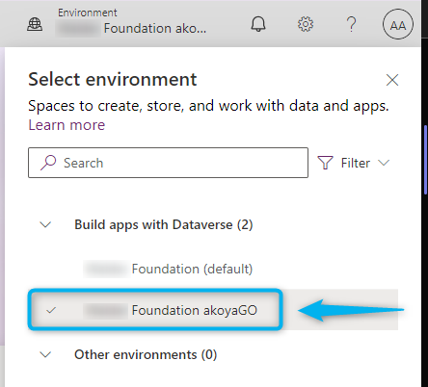

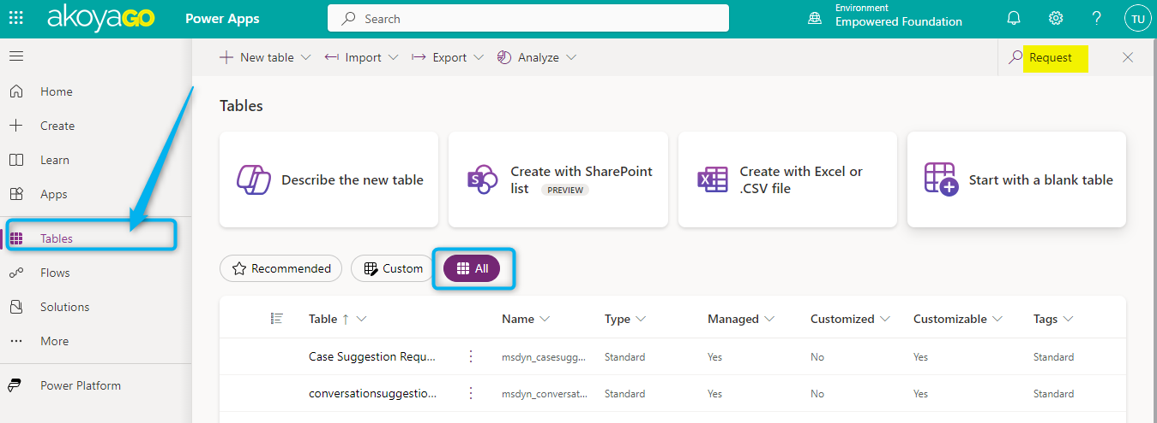
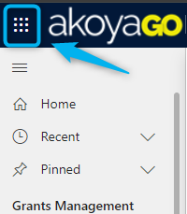
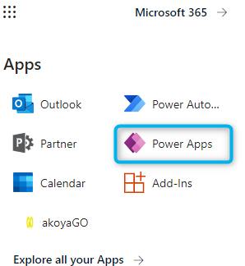

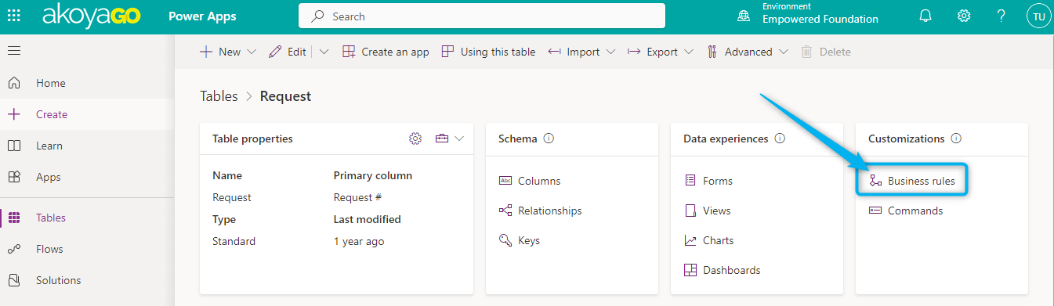
WHERE TO CREATE BUSINESS RULES
Business Rules can be found in Microsoft Power Apps (make.powerapps.com)
Solutions > Table >Business Rules
Select your foundation’s akoyaGO Environment
(It should not be the
default environment)
To access Power Apps, you must be an akoyaGO admin and have the akoyaGO Customizer role.

Slide 11
LET'S BUILD A BUSINESS RULE!

Slide 12
Workflows automate business processes without a user interface. Workflow processes can be used to initiate automation that doesn’t require any user interaction.
Each workflow process is run on one table in akoyaGO and can impact related tables.
WORKFLOW PROCESSES
Notes:
https://learn.microsoft.com/en-us/dynamics365/customerengagement/on-premises/customize/configure-workflow-steps?view=op-9-1
https://learn.microsoft.com/en-us/dynamics365/customerengagement/on-premises/customize/workflow-processes?view=op-9-1

Slide 13
Notifications (Emails): When a gift is received over $5,000, create a task for staff to write a custom thank you letter
Create child records: Auto-create a Payment record, when a Request is approved
Create activities: When a new fund is established, create tasks assigned to staff to complete fund setup
Fill fields based on related records: If the payment memo is blank, then set the memo on payment and requirement record to = request number + title of request
USE CASES FOR WORKFLOWS
Notes:
https://learn.microsoft.com/en-us/dynamics365/customerengagement/on-premises/customize/create-business-rules-recommendations-apply-logic-form?view=op-9-1
Does not cross entities
Cover first
- similar and not similar to workflows
Convey why one over the other.

Slide 14
CONSIDER BEFORE YOU BUILD
When do you want the workflow to start?
Should the workflow run as a real-time workflow or a background workflow?
What actions should the workflow perform?
Under what conditions should the actions be performed?
Notes:
Real time – user sees action immediately and error message appears on screen.

Slide 15
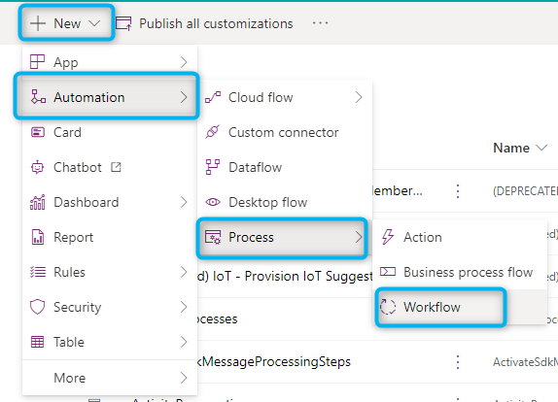
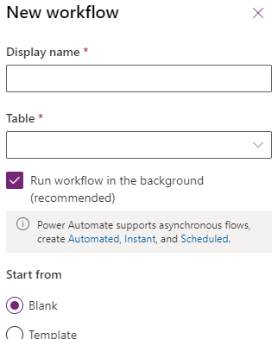
PROPERTIES FOR NEW
PROCESS WORKFLOWS
Display Name: Unique name of the workflow process. Should be descriptive of the automation. Consider establishing a naming convention.
Table: Entity/Table in akoyaGO. Cannot be changed after it is set. This is where the workflow can be run.
Background workflow vs. Real-Time workflow: Real-time workflows run immediately while background workflow allows for wait conditions.
Start from: “Blank” means the workflow will be built from scratch; “Template” allows you to build it from a previously saved workflow guide.
Notes:
Background workflow easier to troubleshoot – stores successes

Slide 16
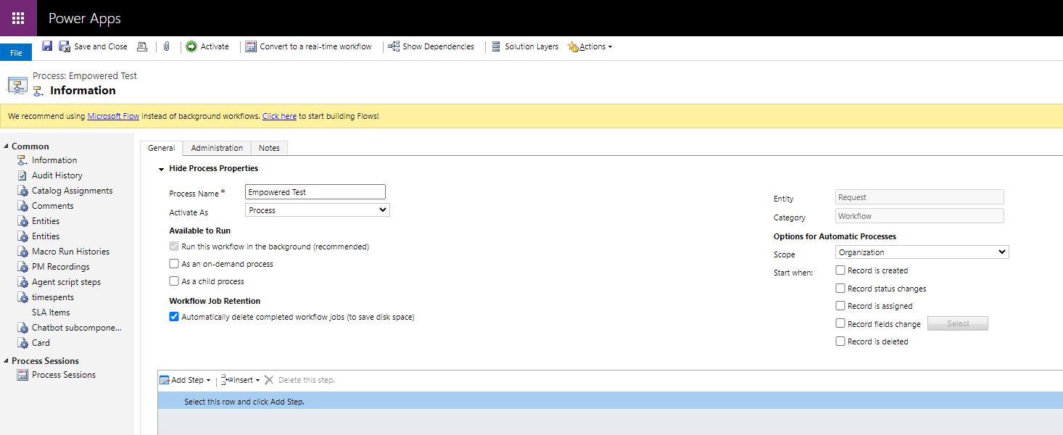
WORKFLOW PROPERTIES (CONT.)
Activate As: Select “Process” to initiate automation right away. Select “Process template” if you have several similar workflow processes to create and want to define them without duplicating the same logic.
Available to Run: “On-Demand Process” allows users to run this workflow manually at any time they choose. “As a child process” allows the workflow to be started from another workflow.
Workflow Job Retention: Keep the default option selected to save storage space.
Notes:
Use workflow Job retention to store logs

Slide 17
WORKFLOW PROPERTIES (CONT.)
Options for Automatic Process:
Scope – Always set to Organization, so workflow logic can be applied to any record in the organization. Otherwise, the workflow can only be applied to a subset of records that fall within the scope.
Start When - use the options in this section to specify when a workflow should start automatically.
Record is created – on initial save of a new record in the specified table
Record status changes – “Status” changes to Active or Inactive
Record is assigned – “Owner” field changes
Record fields change – can specify to run when certain fields are modified on the record
Record is deleted – when a record in the table is deleted
Notes:
Generally – want to be organization

Slide 18
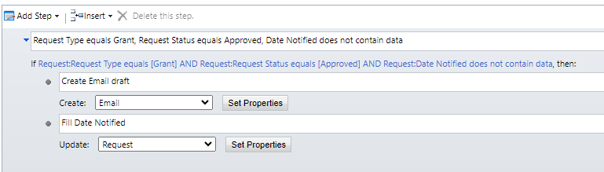
WORKFLOW STEPS
Steps are a unit of business logic within a workflow.
Steps can include conditions, actions, other steps, or a combination of these elements.

Slide 19

WORKFLOW ACTIONS
Action | Description
Create Record | Creates a new record for a table and assigns values you choose to the new record fields.
Update Record | You can update the record that the workflow is running on, any of the records linked to that record in a many to one relationships, or any records created by earlier steps.
Assign Record | You can assign the record that the workflow is running on, any of the records linked to that record with a many to one relationship, or any records created by earlier steps.
Send Email | Sends an email. You can choose to create a new email message or use an email template configured for the entity of the record that the workflow is running on or any entities that have a many to one relationship with the entity, or the entity for any records created by earlier steps.
Start Child Workflow | Starts a workflow process that has been configured as a child workflow.
Change Status | Changes the status of the record that the process is running on, any of the records linked to that record with a many to one relationship, or any records created by earlier steps.
Stop Workflow | Stops the current workflow. You can set a status of either Succeeded or Cancelled and specify a status message.
Notes:
Stop workflow – for branches
- Cancelled – use to store unsucceeded jobs
One to many – “why” – how would it know what to update

Slide 20
WORKFLOW CONDITIONS
Condition Type | Description
Check Condition | A logical "if-<condition> then" statement. You can check the current values for the record that the workflow is running on, any of the records linked to that record in a many to one relationships, or any records created by earlier steps. Based on these values you can define additional steps when the condition is true.
Conditional Branch | A logical "else-if-then" statement, the editor uses the text “Otherwise, if <condition> then:”
Default Action | A logical "else" statement. the editor uses the text “Otherwise:”
Wait Condition | Enables a background workflow to pause itself until the criteria defined by the condition have been met. The workflow starts again automatically when the criteria in the wait condition have been met.
Parallel Wait Branch | Defines an alternative wait condition for a background workflow with a corresponding set of additional steps that are performed only when the initial criterion is met. You can use parallel wait branches to create time limits in your workflow logic. They help prevent the workflow from waiting indefinitely until the criteria defined in a wait condition have been met.

Slide 21
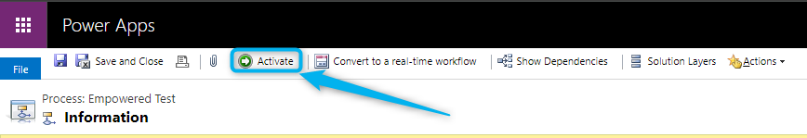
ACTIVATE WORKFLOW
Once the Workflow is complete or ready to be tested, activate the workflow.
Please note: Workflows cannot be edited when activated.

Slide 22
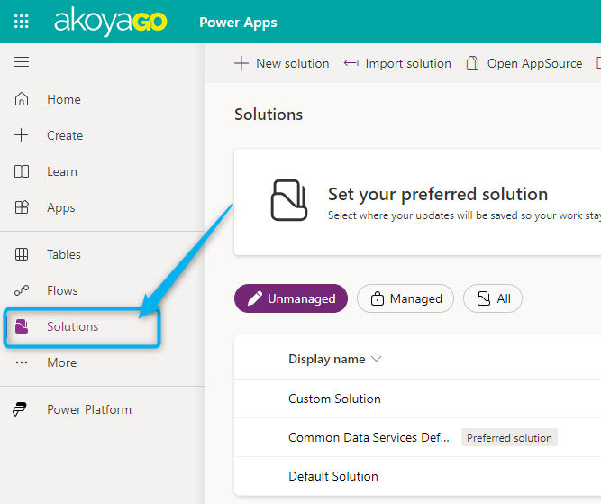
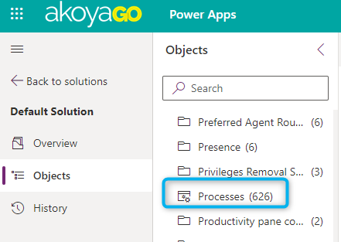
WHERE TO CREATE
WORKFLOW PROCESSES
Processes can be found in Microsoft Power Apps (make.powerapps.com)
Solutions > Solution Objects > Processes
Select your foundation’s akoyaGO Environment
(It should not be the default environment)
To access Power Apps, you must be an akoyaGO admin and have the akoyaGO Customizer role.
Notes:
Emphasize custom solution unless not there than default, move how to get there to after.

Slide 23
LET'S BUILD A WORKFLOW!
Notes:
Overview: Skip describing will do explaining in example you can refer back to slides

Slide 24
Business Rules: https://gosupport.powerappsportals.com/knowledgebase/article/KA-01529/en-us
Process Workflows: https://gosupport.powerappsportals.com/knowledgebase/article/KA-01531/en-us
RESOURCES
Notes:
https://learn.microsoft.com/en-us/dynamics365/customerengagement/on-premises/customize/create-business-rules-recommendations-apply-logic-form?view=op-9-1

Slide 25
PRESENTED BY
Claire Nyenhuis
Senior Project Manager
THANK YOU

