Slide 1



Share your photos to
the conference album!
#EMPOWERED2024

Slide 3
EMAIL TEMPLATES AND COMMUNICATIONS
PRESENTED BY
Tyler Long | Manger of Technical Services

Slide 4

EMAIL TEMPLATES
AND EDITOR
An accessible method for your organization to set up and create an email template.

Slide 5
NAVIGATION & WHERE TO EDIT
Email Templates in Tools vs. Editing Processes
Consistent naming conventions for editing

Slide 6
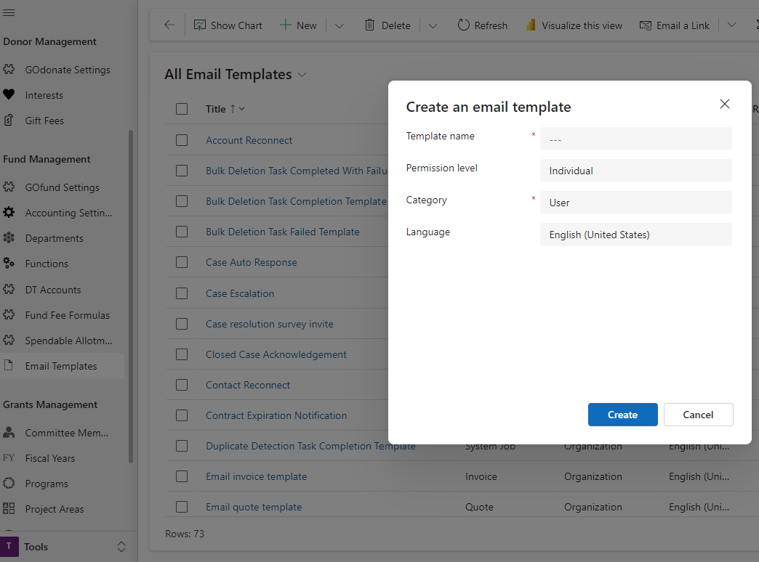
HOW TO CREATE AN EMAIL TEMPLATE
Navigate to the Tools Workplace and select Email Template.
When selecting the category this is the entity that you will be able to run the email template from.

Slide 7
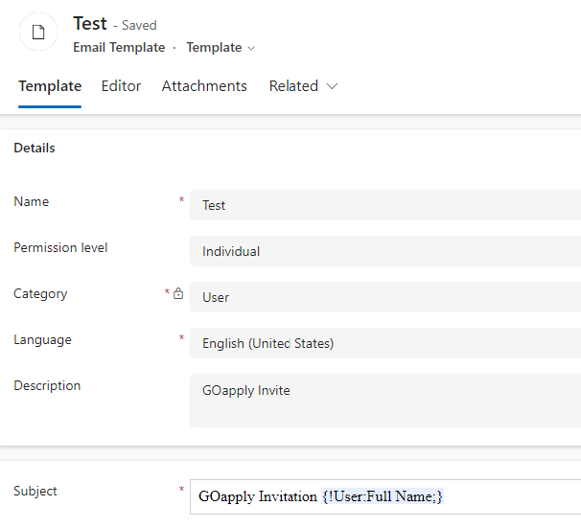
HOW TO CREATE AN EMAIL TEMPLATE
Permission level: Organization or Individual
Dynamic content
    For custom entities or fields, you need to follow a specific syntax

Slide 8
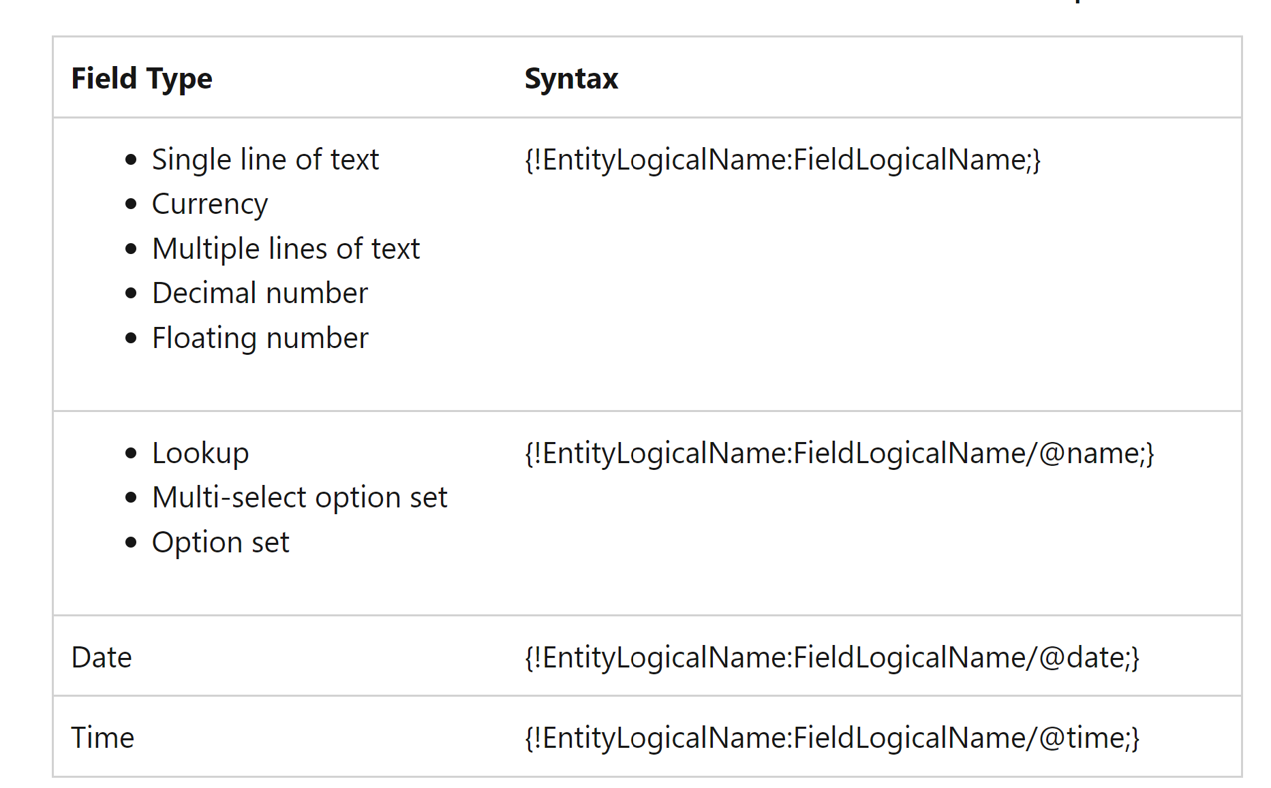
Custom Fields: Syntax

Slide 9
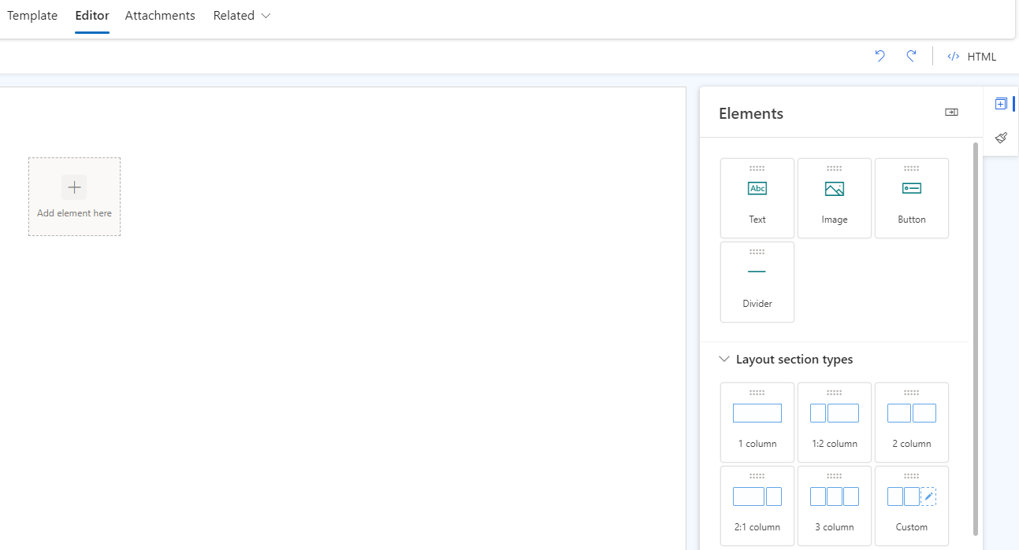
EDITOR
In the Editor Tab, you can design your template by selecting different layout types and elements such as images or clickable buttons with links to a certain webpage.

Slide 10
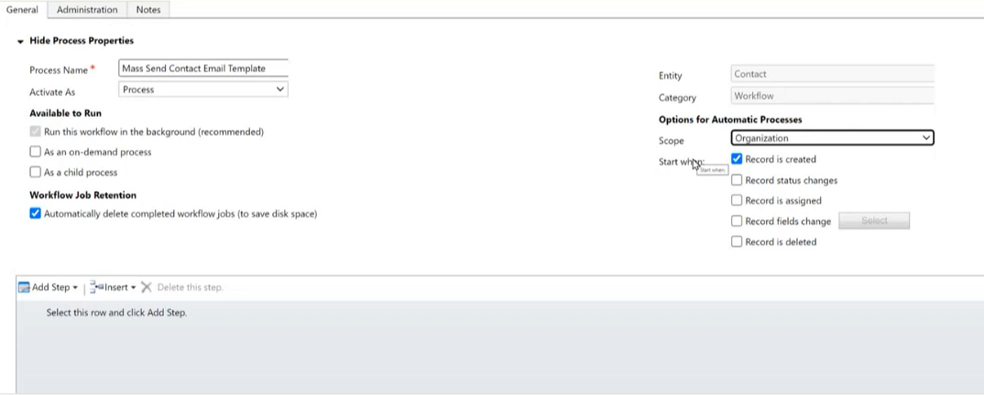
ADVANCED SETTING
Pair your template with a process workflow in the Advanced Settings Processes.
Select “New” and then the category “Workflow” to connect the entity the template was made for.
Available to Run: As an On-Demand Process

Slide 11
PROCESS
Add Step and select Send Email
“Create new message” drop-down and switch to “Use template” to select the template that was created
Activate the flow

Slide 12
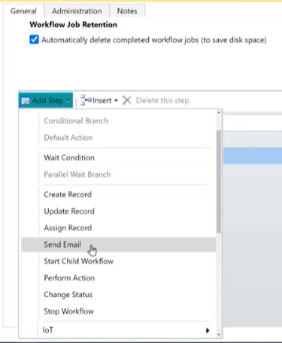
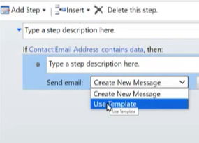

PROCESS
Notes:
Also go over the create draft option

Slide 13
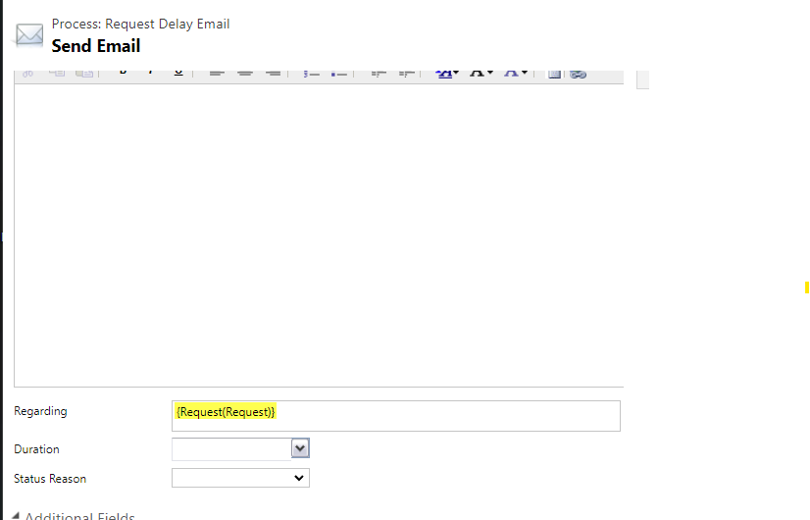
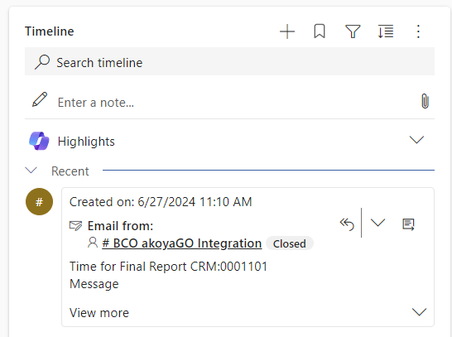
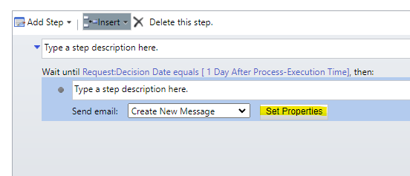
PROCESS – TRACKING BACK TO A RECORD IN CRM
Notes:
Also go over the create draft option

Slide 14
An automated process without the need for direct interaction saves time by completing actions that would typically require manual entry.
PROCESS WORKFLOWS

Slide 15
WHAT CAN A WORKFLOW CREATE?
Records
    Create
    Update
    Assign
Modify Data
    Change Status
Perform actions based on conditions that you set

Slide 16
Components
Stage
    Used to split a workflow into sections.
Check Condition
    Made up of an “IF” statement followed by a “THEN” statement.
    Example: If a grant amount is greater than $0, then create a draft email award email.

Slide 17
COMPONENTS
Conditional Branch
  Can only be created directly after a Check Condition.
  Otherwise, If, Then statement.
    Example: Otherwise, if a grant is denied, then create a draft denial email.
Default Action
  Runs a series of steps if the Check Condition and Conditional Branch fail.

Slide 18
WORKFLOW − WHY & LIMITATIONS
A Process Workflow should be created if more actions need to be taken than updating one field.
Workflow actions only happen within the CRM.
    Updating fields
    Sending an email
    Creating a payment

Slide 19
LETTER TEMPLATE ENTITY

Slide 20
WHY LETTERS ENTITY
It allows the maximum flexibility of creating communications that save to the record and in a batch.
It allows the user to self-design the template in the CRM without the need for complex knowledge of tools such as PowerAutomate.

Slide 21
DEMO
A view containing all the fields you want to dynamically populate in your letter.
Produce your Letter Template in Word

Slide 22
DEMO
The following steps outline how to insert a merge field Full Name into the document with Word:
  Navigate to Insert Tab
  Click on Quick Parts to open a drop-down list
  Click on Field... to open the Field dialog
  Select Mail Merge from Categories
  Select Mail Merge from Field names
  Insert FullName text into the Field name text box
  Click OK to close the Field dialog

Slide 23
DEMO
8. Open the Letter Template Entity
9. Populate the Word Document Template that was made
10. "Regarding To"= Table (Entity) the letter is going to run off of
11. Select the view that corresponds to the letter template
12. Return to the view you created and select the records to run a letter for.
13. Click "Generate Letters“

Slide 24
RESOURCES
Building Email Templates and Automated Notifications (Webinar)

Slide 25
PRESENTED BY
Tyler Long
Manager of Technical Services
SUPPORTING PRESENTERS
Parker Robinson
Elizabeth Pi
THANK YOU

