Slide 1
March 2025
Product Update

Slide 2
Agenda
akoyaGO (non-accounting) – Bug Fixes & Enhancements
GOapply – Bug Fixes & Enhancements
akoyaGO with Accounting – Bug Fixes & Enhancements
Business Central – Bug Fixes & Enhancements
GOfund – Bug Fixes & Enhancements
GOdonate – Bug Fixes & Enhancements
Housekeeping
Microsoft Known Issues
Demo of New Features
Demo of New Features

Slide 3
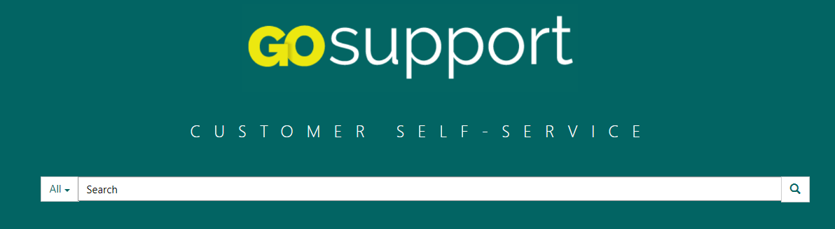
Where Can I Find
Release-Related Resources?
https://gosupport.powerappsportals.com
Release Notes
Updated Documentation
Recording of this Session

Slide 4
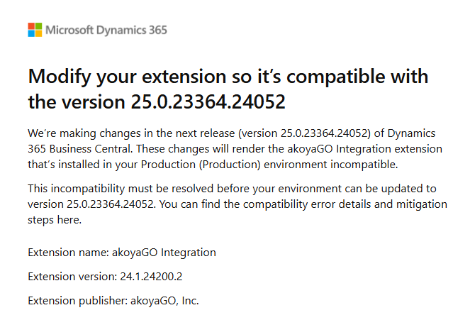

Housekeeping Housekeeping
Utilize GOsupport announcements to keep up to date on these items between product updates
Keep an eye on “Announcements”
Microsoft Email Re: “extension isn’t compatible”
Subject: Modify your extension so it’s compatible with the version 25.0.23364.24052
If the extension in reference is “akoyaGO” – you do not need to worry about this – akoyaGO has it covered!
Notes:
This has been identified as a Microsoft Bug and our team is working to provide a solution. At this time, we encourage you to avoid editing email templates that include links for the interim. If you have any Email Templates that need to be edited, please submit a support case for our team to work through your template adjustments specifically.
This is a reported Microsoft issue that we are working with their team to correct. As a workaround, please carefully monitor your date selections after save. Users are reporting that the vast majority of the time, when they return to the record, reselect the correct date and re-save it, the date is saving correctly.

Slide 5
Microsoft Known Issues
Microsoft bug regarding email templates
When editing Email Templates with links (URLs) in Tools workspace, the autosave process is causing any embedded links to malfunction within the template.
Microsoft bug: Date picker fields reverting intermittently
Users have reported that date fields within the CRM are not working as expected. This occurs when a date is selected using the calendar selector and upon save, users notice that the date reverts to the date prior to what was selected.
Notes:
This has been identified as a Microsoft Bug and our team is working to provide a solution. At this time, we encourage you to avoid editing email templates that include links for the interim. If you have any Email Templates that need to be edited, please submit a support case for our team to work through your template adjustments specifically.
This is a reported Microsoft issue that we are working with their team to correct. As a workaround, please carefully monitor your date selections after save. Users are reporting that the vast majority of the time, when they return to the record, reselect the correct date and re-save it, the date is saving correctly.

Slide 6
Bug Fixes
Team users can now delete personal views and dashboards
We have fixed a bug with letter generation in which the compile pdf job would time out during big jobs. This feature can now generate letters for up to 250 records at a time.
We have fixed a bug in which the special request status of In Review did not clear if the Deny grant command bar action was taken.
We have fixed a bug in which the special request status of In Review did not clear if the Deny grant command bar action was taken.

Slide 7
Enhancements
In request payment records, the payments and requirements have been split into two separate subgrids.
Several System Views have been updated. Please see release notes for a detailed description of those updates.
When “Original Grant” is filled in, you will now see a pop-up asking you if you want to clear the special request status.
In the Activities section, the views "All Activities" and "All Emails" are now sorted by date created, newest to oldest.

Slide 8
Demonstrations
GOapply Choices in form editor
Enhanced validation on mapping choice fields
Add to review group buttons
Advance to next phase functionality
Impersonate user (choose your site setting)
Mailing Lists
akoyaGO’s alternative to Marketing Lists
Enhancements that make it easier than ever to add requests to review groups
Skipping Phases in GOapply Opportunities? We’ve got you covered!
Enhancements made to our impersonation feature that now incorporate multiple site settings on a user

Slide 9

Bug Fixes
Users were getting an error message when attempting to open the Form Editor on a Phase that has not been saved. To mitigate this issue, the Form Editor tab will not be visible on GOapply Phase until the Phase is initially saved upon creation.
We have fixed a bug in which, when Requested Amount existed as a pre-mapped field, advancing to the phase with that field would cause the payment/requirement creation workflow to run and resulted in Requests having duplicate payments and/or requirements.
We have fixed a bug in which users were not able to see the list of opportunities if the GOapply site was different from the site they registered in (if utilizing multiple GOapply sites).
We have fixed a bug in which individual users were able to register multiple times with the same email, causing duplicate GOapply User records. Users will now be alerted if the email they are using is taken by another GOapply user.
We have fixed a bug wherein the Registration Type GOapply setting was not preventing users from logging in based on their user type in cases where a single organization has multiple GOapply sites.
In response to certain users being unable to utilize the "Advance to Next Phase" button, we have given all team and administrator user roles the ability to utilize this feature
We have removed Header font types from the html editor field in Form Editor because these font types were not rendering correctly in the submitted PDF.
If you are using this in your applications, please remove it.
We have fixed a bug in which mapping was failing on a date field that had an invalid format but the error was not recorded on the GOapply Status Tracking record. Going forward, mapping errors will be recorded in the timeline of the GOapply Status Tracking record.
We have fixed a bug in which, when using the Duplicate Opportunity workflow, the Summary and Description text fields were not visible to applicants on GOapply.

Slide 10

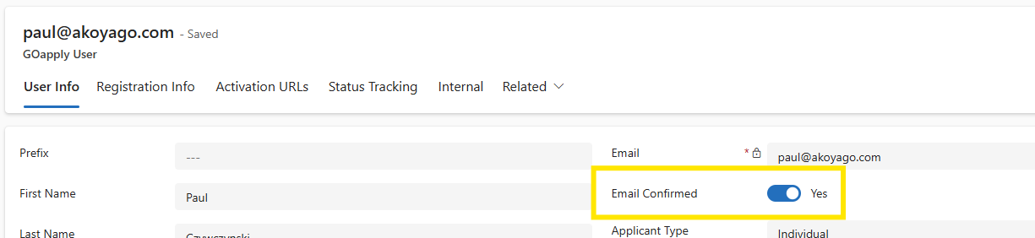
Bug Fixes
The old GOapply V1 field was deprecated and removed from the GOapply User form.
A new field was created that matches the naming of GOfund and GOdonate, then added to the GOapply User form.
If the field is null or empty, it is considered TRUE. Otherwise, the default value for new records is FALSE.

Slide 11
Enhancements
Removed the following entities from the site map:
Review Group Applications
Review Request Scores
Review Responses
All of these are linking tables and do not need to be accessed directly. Best practice is to access these associated records via the Review Group table.
The "Reviewer Bulk Import" table has been re-labeled and is now called "Add GOapply Users." The updated label provides a better description of the table's functionality.
Scholarship Automatching is now available in GOapply. This feature works with scholarship eligibility criteria in your CRM to match applicants with scholarshps they are eligible to apply for. See the Scholarship Automatch knowledge article in GOsupport for more information.
Users will now have the option to reveal their password when logging in
Adding requests to a review group can now be done through a command bar button on Request and Status Tracking records. This process will also validate that the phase is submitted and matches the phase set on the Review Group record. See the GOapply Reviewer Admin Guide for more information.
Notes:
Is Goapply reviewer process turned on oob?

Slide 12
Enhancements
When impersonating a GOapply User, you may now choose the GOapply site in which you want to impersonate (if utilizing multiple GOapply sites).
Users will no longer be able to make changes to a phase that is part of a currently published opportunity. This goes against GOapply best practice. To edit a phase form, you now must unpublish, make your changes, then re-publish.
The Advance to Next Phase command bar button now allows you to select which phase you want to advance to.
Duplication of review groups can now be done through a command bar button on Review Group records.
The Update Form Definition workflow has been moved into the code and can now be run via a command bar button on GOapply Status Tracking records/views. Please see the GOapply Admin Guide for more information.
In an effort to reduce submission issues, we added additional validation on fields with the GOapply UI, specifically, when the applicant clicks “Submit”
Notes:
Is Goapply reviewer process turned on oob?

Slide 13
with Accounting - Demonstrations
Scheduled Distributions
User Change Requests
Default Fund Statement Report Layout
Reversals and Adjustments added features

Slide 14
with Accounting – Bug Fixes

Slide 15
with Accounting – Enhancements
Schedule Distributions
New field Distribution Override Date allows the user to specify the date to be used for the next distribution.
New field: Distribution Type differentiates between grants and interfund grants (new workflow to populate “distribution type” on Scheduled Distributions)
The scheduled distribution form has been rearranged for user friendliness.

Slide 16
with Accounting – Enhancements
Reversals & Adjustments Feature:
Now handled with a command bar button
Refunded Amount
Parent Request Payment
New fields on request payments:
Enhanced validation
Adjust payments instead of reversing themApply multiple refunds to a single payment

Slide 17
Business Central – Enhancements
Users are no longer able to update the GL Memo in request payments if the payment is part of an unposted journal batch.
When a check is financially voided from the check ledger, the sync back to CRM will happen immediately
Users are no longer able to update the GL Memo in gift payments if the payment is part of an unposted deposit.
Notes:
Updated for 9/12

Slide 18

Bug Fixes
GOfund no longer supports attempts to repeat an interfund grant to a fund that is no longer active.
We have fixed a bug in which entering an Email Sent date on new Donor Portal Access fund connections was not preventing the invitation email from sending.

Slide 19
Enhancements
All Rich Text fields in GOfund Settings now have a maximum character count of 1,048,576. This is the max amount set by Dynamics 365 and cannot be increased beyond that number. Reminder: for "Rich Text" fields, it is counting the HTML characters, so if you have excessive formatting in this field, it will increase your character count significantly.
GOfund profile change requests: GOfund users can now request changes to their profile. Please see the GOfund Profile Change Requests knowledge article in GOsupport for more information.
Users will now have the option to reveal their password when logging in
When utilizing two-factor authentication, the email that contains the code will be recorded on the contact to which the email was sent.
We have added a GOfund setting to allow/disallow the Primary Fund Donor to be displayed on the fund summary.

Slide 20

Bug Fixes

Slide 21
Enhancements
Character limits on all rich text fields have been increased to the maximum allowed by Dynamics 365: 1,048,576
GOdonate confirmation email activities will now set the Regarding as the GOdonate Transaction record.
Users will now have the option to reveal their password when logging in
Users will no longer be allowed to manually create recurring gifts. This table is for recurring gifts created via GOdonate only.

Slide 22
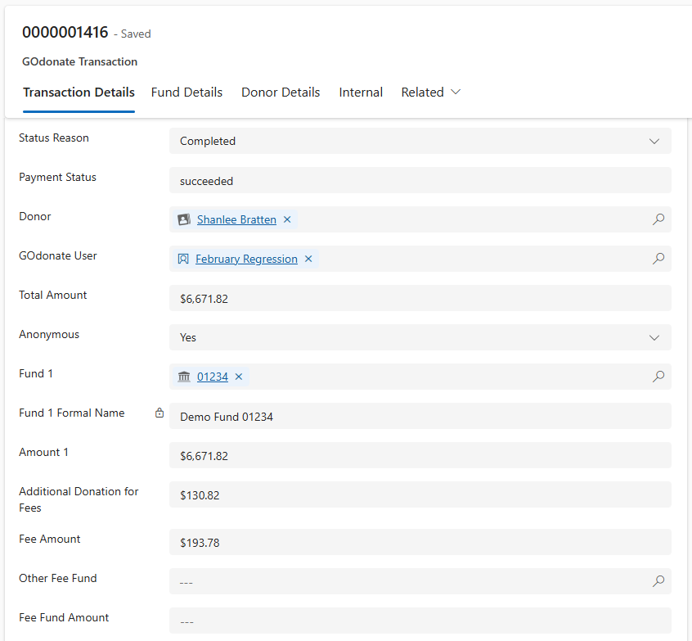
Enhancements
GOdonate Fees on GOdonate Transaction
New fields for Other Fee Fund and Fee Fund Amounts
Additional Donation now included in either Amount 1 or Fee Fund Amount
No change to data in Gift/Gift Payment Records
Notes:
When the fund paying the fee is the gift fund the additional amount is added to the amount reflected in Total Amount and Amount 1.
The actual Stripe fee will be captured in Fee Amount.
When the fund paying the fee is other fund the donor covered fee is reflected in Total Amount and Fee Fund Amount.
A new field called Other Fee Fund will reflect the fund selected to pay the fee

Slide 23
Thank you!
Don't forget to clear your cache Friday Morning to ensure you receive all the updates!

